Slide 1
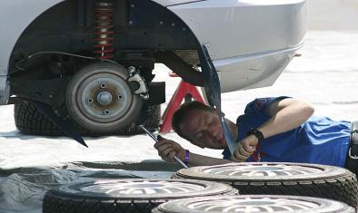
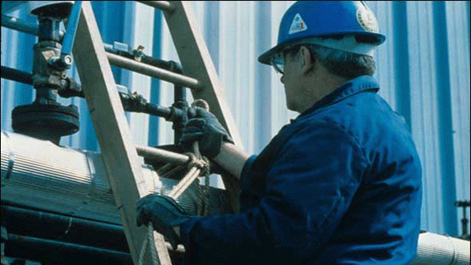
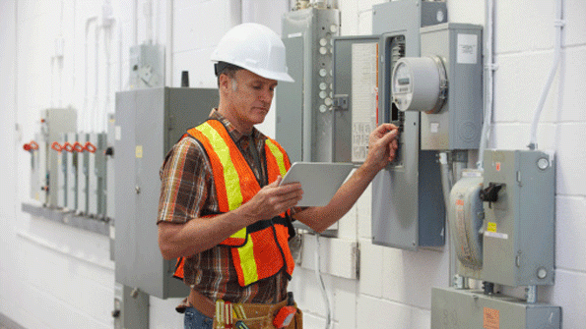
Safety When Working Alone
Bureau of Workers’ Compensation
PA Training for Health & Safety (PATHS)
Notes:
'Working alone' is working anywhere a person is unable to get immediate assistance from colleagues or other people. In some cases other people may be close by, such as a cleaner working by themselves in a city office building. In other cases the employee could be in a remote location, such as a researcher undertaking field work in a park.

Slide 2
Topics
Employees Who Work Alone
Potential Work Alone Situations
Assessing Jobs for Safety
What to do if Situations
Safety Considerations
Notes:
Our program will discuss the topics listed.

Slide 3
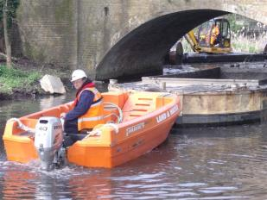
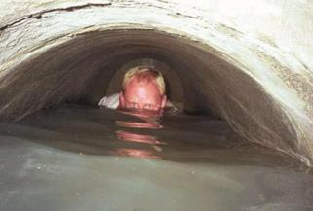
Employees Who Work Alone
Each year individuals who work alone are injured or become fatalities; this could have been prevented had plans and policies existed
Notes:
There are many scenarios in many occupations where these circumstances could apply, for example:
Sales representatives, including real estate agents
All-night convenience store and service station attendants
Transport freight and public transport drivers
Doctors, health and community workers
Rural and agricultural workers
Scientists, park rangers or others undertaking field work.
www.worksafe.vic.gov.au

Slide 4
Employees Who Work Alone
While OSHA does not require a special plan for those working alone, OSHA’s General Duty Clause requires the employer to provide a safe workplace for employees.
Notes:
Always decide on the side of Safety for you or your staff when evaluating potential issues which may affect their safety.

Slide 5
Employees Who Work Alone
Adopting the General Duty clause becomes a “best practice” using such plans and procedures to promote safety.
Notes:
While there is no specific legislation, rules or regulations from OSHA governing those who work alone, the General Duty clause is often invoked.
This states the employer is responsible for the creation of a safe work area for their employees.
Even if not obliged to comply with OSHA, the adoption of their recommendations is working toward achieving Best Practices as it regards safety.

Slide 6
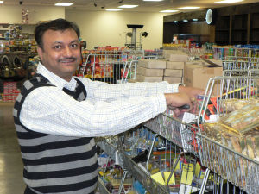
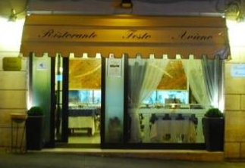
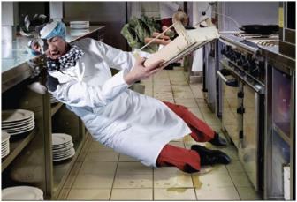
Potential Work Alone Situations
Service stations and all-night establishments
Mini Marts
Diners/Restaurants: Shut-
down person
Accidents
Invasive actions
Notes:
Possible situations which may impact on employees who work alone could include the environment itself, or how it might be changed. Example above is a worker slipping on a wet floor.
After hours situations can occur that involve lighting, persons or the environment.

Slide 7
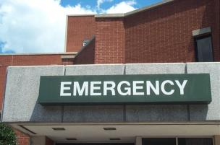
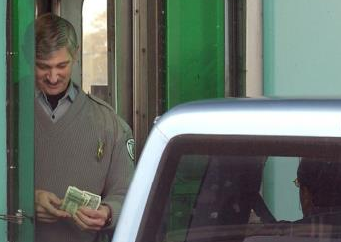
Potential Work Alone Situations
Hospital Emergency Rooms Irate family members or injured persons
Toll Takers: Booth crashers, medical incidents, lost or frustrated motorists
Notes:
Hospital Emergency Rooms can become hazardous. Irate family members who feel a loved one is not getting fast enough service; multiple victims from traffic accidents can inundate the staff and capacity of the ER. Gang-related incidents where victims are brought together in the same area as well as victims from tavern or bar altercations who want to continue the “battle” even in the ER.
Toll Takers can have problems with booth crashers who don’t want to pay the toll. Medical incidents can occur as well as lost or frustrated motorists.
Other types of Booth Crashers include traffic incidents where a motorist may lose control of the vehicle and impact the booth or another vehicle.

Slide 8
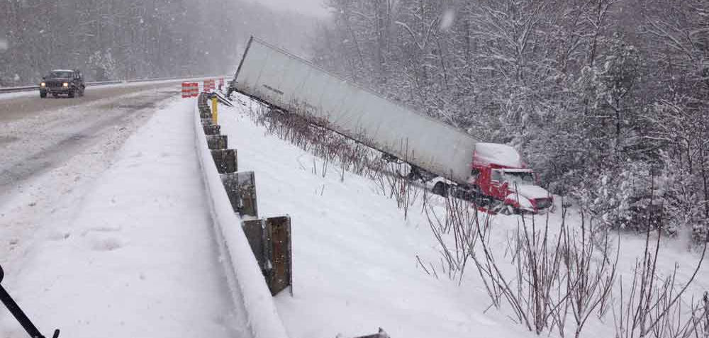
Potential Work Alone Situations
Transportation Industry: Hijackings and seasonal concerns as well as hours of operation leading to accidents
Notes:
The Transportation Industry for trucking is subjected to seasonal concerns which could lead to accidents. Hijackings, as in the past, may yet continue.
Problems between trucks and motorists may happen to cause tempers to flare resulting in altercations.

Slide 9
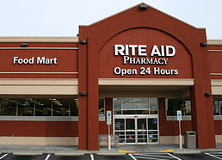
Potential Work Alone Situations
24-hour Pharmacies: Robberies, anxious patrons
Notes:
Any facility open round-the-clock (24 hours) may be subject to various types of incidents:
Robberies, theft, vandalism, people in a rush. The problem is increased for those working alone due to being responsible to attend to the problem and possibly need to call for help.
Multiple duties may distract the worker and make the facility and themselves vulnerable.

Slide 10
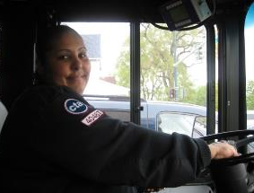
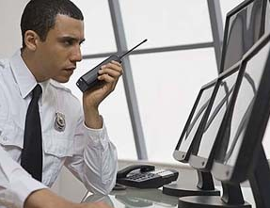
Potential Work Alone Situations
Taxi and Bus Drivers
Security staff
Any location open 24 hours or after hours and dealing with public
Notes:
Taxi Drivers don’t know who their fare might be. As vast as are the types of personalities, so might be the types of incidents to impact them.
Bus Drivers may have a normal route, but may not have routine, familiar clientele.
Security Staff, by the very nature of their duties, may be targeted by those who want to compromise the security system and commit offenses.

Slide 11
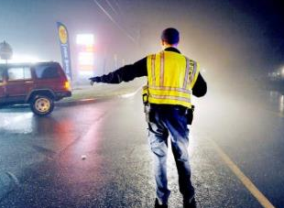
Potential Work Alone Situations
Law Enforcement (Special Assignments): vehicle incidents, drive-by shootings, medical problems.
Any location in isolation dealing with public, equipment, or an actual or potential hazardous situation
Notes:
Law Enforcement (Special Assignments) such as traffic control for road impediments or closings, vehicle accidents or securing a location may meet with the public who refuse to be convinced that they can’t go through because they “live just down the road.” Some, when informed they’ll have to take an alternate route will state they don’t know any other way to get home. When asked how long they’ve lived at that location, some have indicated 42 years.

Slide 12
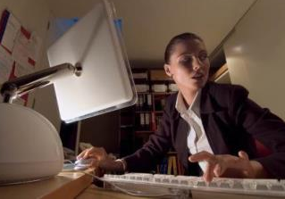
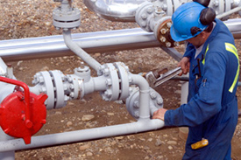
Potential Work Alone Situations
Night shift workers or after-hours jobs:
Domestic incidents
Robberies/theft
Vandalism
Specialty Service Work Sites: Uncontrolled energy or material releases, personal injuries
Notes:
Night shift or during hours of darkness pose their own possible hazards. This includes distance from building to parking lot, availability to summon help due to a person-to-person incident and traffic problems. Often dark areas are possible ambush points.
Specialty Service Work Sites: systems under pressure or problems with valves may allow uncontrolled material or energy releases.

Slide 13
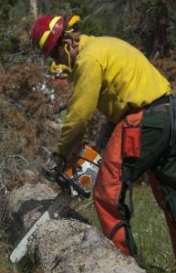
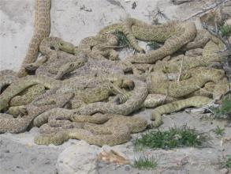
Potential Work Alone Situations
Forestry Service activities: Absence of phone relay towers, equipment injuries, wildlife hazards
Game Commission Officers: Armed poachers, wildlife hazards
Notes:
Forestry: work alone in parks and woodlands and possibly cut-off from communications in some areas.
They may confront armed persons hunting or fishing illegally who will challenge the officer’s authority.
Crews clearing deadfall using power tools may be subject to accidents requiring immediate medical attention.
Areas may be inaccessible to vehicular traffic.
Wildlife hazards include rabid animal bites and snake bites as well as encounters with bears.

Slide 14
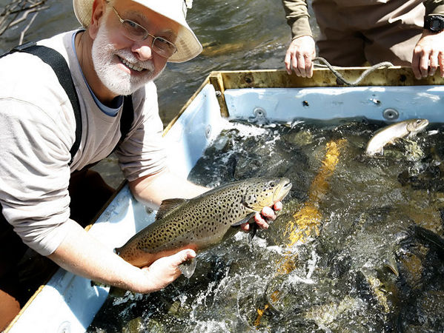
Potential Work Alone Situations
Fish & Boat Commission Officers
Notes:
Fish and Boat Commission Officers may not work completely alone, but might be subject to the same limitations as others in the wild. This would include water accidents, strains, sprains and falls coupled with environmental hazards.
Water always presents a chance for accidental drowning. Cuts, insect bites, and back injuries may also occur. Also, if on duty during the first day of Trout Season, dealings with irate persons may occur.

Slide 15
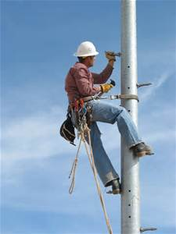
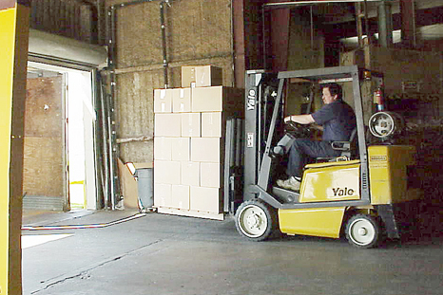
Potential Work Alone Situations
Utility Linemen: shock or electrocution, falls from heights
Shipping/Receiving: falling stock, vehicle overturns
Notes:
Utility Line Workers can be subjected to electrical hazards during all types of weather. Since downed lines and disruptions may be caused by bad weather, restoration may also have to be performed during the same conditions. Vehicular incidents may also occur if the line truck needs to park on the berm or close to intersections.
Shipping and Receiving incidents may include driving forklifts off edges or on uneven terrain. Struck-by situations may also occur due to visibility problems.
Since shipping concerns moving a product “out,” cuts may occur during packaging or opening, lifting strains may also happen.
Forklifts improperly powered for an environment may be a hazard, e.g. propane powered or gasoline powered inside an enclosed area (carbon monoxide build-up).

Slide 16
Potential Work Alone Situations
Working from home: Trip and falls, electrical issues, fires, poor lighting, ergonomic issues, chemical safety
Notes:
Individuals working from home can face a myriad of issues not the least of which is being alone.

Slide 17
Assess Job for Safety
Assess your facility to determine who may work alone and their activities
What special considerations they might need
What types of incidents may occur
Notes:
Some situations may be found to be unsafe for an individual to work alone.

Slide 18
Assess Job for Safety
This includes being geographically distant within a building or separation from work crew due to task (only one person will fit in a vault)
At out-buildings separated from coworkers and communications
Time of day or night concerns
Field Operations
Notes:
Working alone may involve geographic distance as well as building separations. They include time of day or night concerns and field operations.

Slide 19
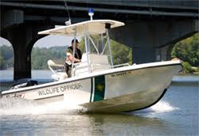
Assess the Job for Safety
Determine hazards or circumstances for each condition, i.e.
Tasks + Tools = Accidents(?)
Tasks – PPE = Accidents(?)
Identify dangerous conditions
Develop procedures
Ensure employee monitoring
Guarantee immediate assistance if needed
Notes:
Remember: Those who work alone work by themselves without direct supervision. They may be mobile, going to field locations. They may also work outside normal daytime hours.

Slide 20
Assess the Job for Safety
Determine fitness of individual to safely perform duties.
How is it determined that a lone person can do the job
Are there medical restrictions to the work
Is any type of supervision required
Types of emergencies which may arise and means to respond
First Aid training and equipment provided to lone worker
Establish limits to work activities
Notes:
Assess the job for safety.
Can the lone person do the job
Are there medical restrictions
What supervision may be required
Types of emergencies which may arise and how to respond
First Aid training and equipment required
Work limits established for activities?

Slide 21
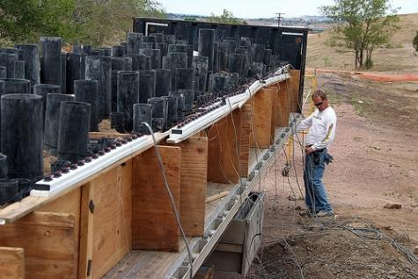
Assess the Job for Safety
Provide required tools and equipment
Provide information concerning potential hazards
Assure ability to contact assistance
Notes:
Pyro technician doing a set-up. This requires a specific sequence of actions to guard against pre-ignition and explosive tragedy.

Slide 22
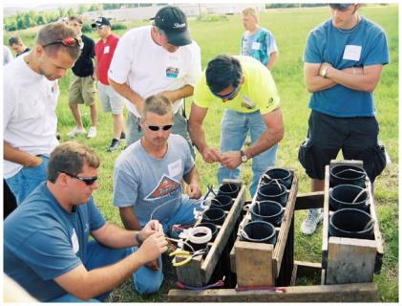
Assess the Job for Safety
Train to familiarize workers, supervisors and foremen of hazards and response
Train regarding equipment to ensure safety
Brief on Policies and Procedures in effect
Notes:
Pyro technician training. Do they understand what you said; for example, how to do it; when to do it; and what not to do?

Slide 23
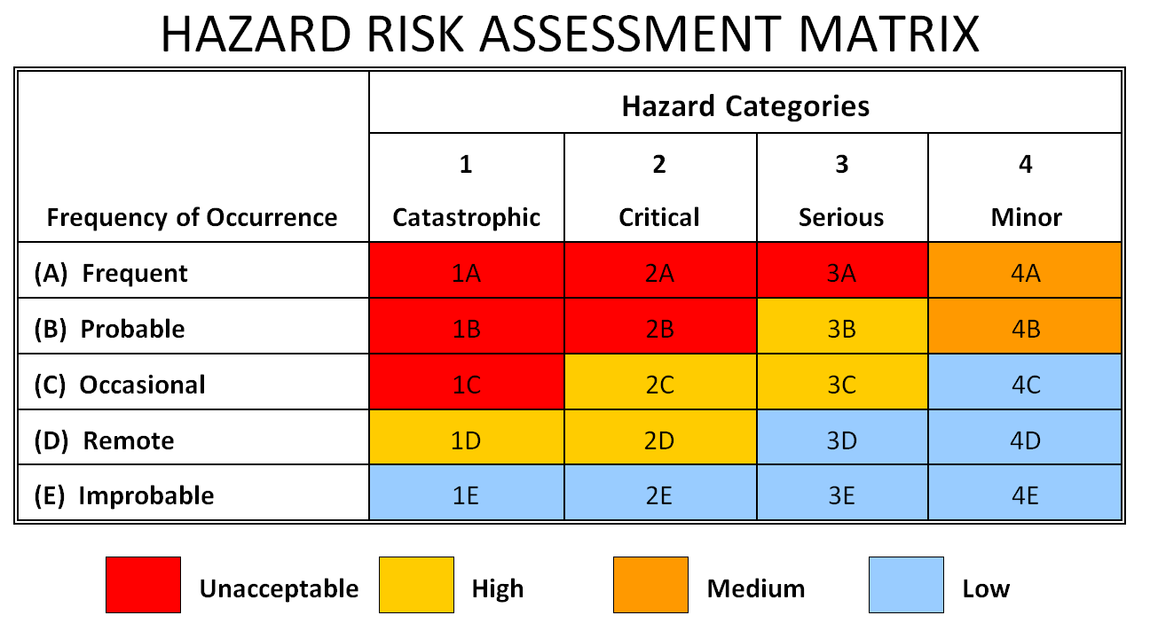
Categorize the Jobs
Assign a High Risk or Low Risk (or combination) to hazard
Notes:
Categorize the hazards of the job. The hazard categories may be trimmed to just 3 levels. Modify according to your needs ensuring all needs are met.

Slide 24
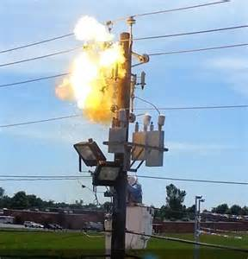
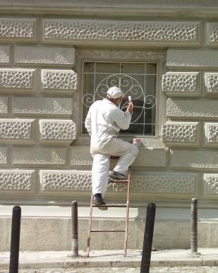
Categorize the Jobs
Design control measures regardless of risk level
Notes:
Magnitude of risk level will dictate your risk assignment. Even seemingly small jobs may breed injury. Think through the process taking into account the possibilities and probabilities of risk.

Slide 25
Control Measures
Are based on the hazard assessment and targeted toward obtaining emergency help when needed.
Some control measures include:
Buddy System
Personal Check
Periodic Telephone Contact
Electronic Communication/Surveillance
Central Monitoring
Shutdown and Isolation Measures
“What To Do If…” Situations
Notes:
Other control measures may also be included depending upon the uniqueness of the task. Seasonal and climatic conditions should always be viewed. Some set-ups, such as erecting scaffolding or ladders, will be effected by inclement weather reducing sound footing.

Slide 26
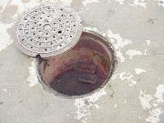
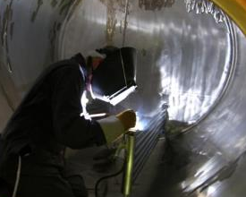
Buddy System
One worker may be separated from other workers in the work environment by distance or barrier between task and other employee
Examples of work alone locations:
Confined spaces
Manholes
Pits
Tanks
Home environment
Notes:
When team members are separated physically or by distance, the physical separation must be taken into account, especially if the need for immediate aid or assistance occurs.

Slide 27
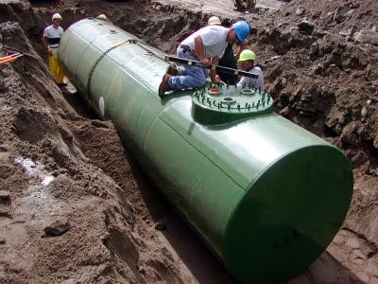
Buddy System
Locations which may be oxygen-deficient or contain harmful vapors may exist
These locations should not be a work-alone situation, another person should be in close proximity
Develop work and rescue procedures to best guarantee safety
Notes:
Regulations already exist requiring a Buddy System where this separation by physical barriers may occur. They include permit-required confined space jobs, trenching and excavating and working at elevated heights.

Slide 28
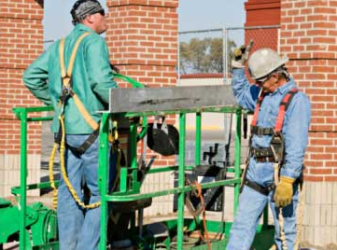
Buddy System
The Work Alone aspect is affected when a space may only permit a single person to enter
This system relies on a proper understanding of hazards and requisite PPE and implementation of emergency rescue
Notes:
Therefore, the Work Alone concept also must view distance of one worker from others. This is especially important when working confined space or elevated height situations.
For those working alone in the field, aid may not be as immediately available as it would were coworkers nearby to begin first aid and call for assistance.

Slide 29
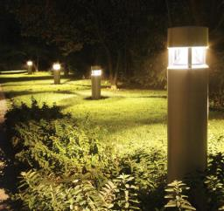
Job Site Security
Security may consist of physical or administrative barriers
Lighting
Create environment of physical barriers
Notes:
Physical barriers to limit entry may also hinder rapid response.

Slide 30
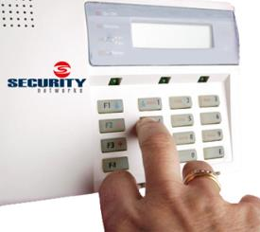
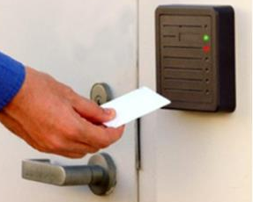
Job Site Security
Alarms: automatic, remote dialers, panic buttons
Locking systems/keycard access
Notes:
Alarms against intrusion serve to exclude non-authorized entry. How would these devices also delay emergency response to provide assistance?
Emergency Buttons or “Panic Buttons” for lone workers should be made available where the threats warrant.

Slide 31
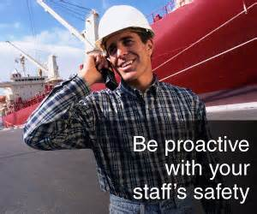
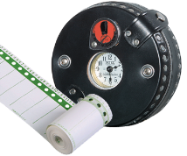
Personal Check
Periodic visits on a timed interval
Various staff may do this but must be trained, assigned and briefed
Time intervals are based on job hazards
Notes:
Periodic checks of your staff working alone will allow you not only to promote their safety but also to do quality checks on their tasks.
In high security environments do not perform these checks on a standard interval such as every hour on the hour; break them up in case someone be watching in an attempt to compromise your security.

Slide 32
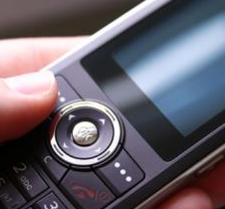
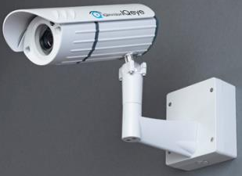
Periodic Checks
At scheduled intervals, periodic checks should be made.
Accomplished by:
Telephone
Electronic surveillance
Work-Alone persons informed of procedures to use
Notes:
Some periodic checks may be made by telephone or via electronic surveillance. Inform your people if they are “under view” by camera and areas which are viewed by the camera. Should something happen, they will know where to stand to get the attention of the monitoring team.

Slide 33
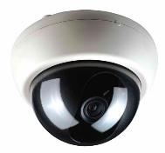
Other Means of Contact
Cell phones
Pagers
Radios
Cameras
Motion detection systems
Notes:
Additional means of contact may be selected. However, ensure each person has a thorough knowledge of their use. Once arriving on location where they will work alone, perform a communications check to determine adequacy of the communications means. This would include the individual performing the check throughout the area or facility where they’ll be working.
Determine “voids” where receipt and transmit may be weak or non-existent. In such cases, devise alternate communication means.

Slide 34
Central Monitoring
By internal staff or external contractors
Alarms relayed to central station
Emergency alarms/automatic dialers
Notes:
Whether a “Central Station” concept or other central monitoring means, have the ability to save and retrieve audio and visual data. This may be needed for investigative purposes in the future.
Ensure all monitors in the central monitoring are trained on normal (routine) operations and emergency actions.

Slide 35
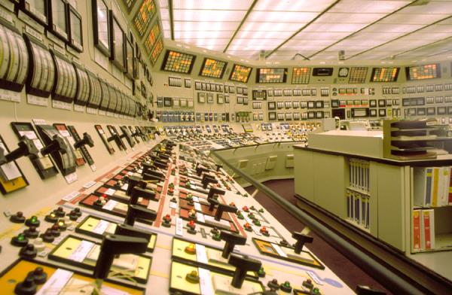
Identify . . .
Locations and identification of shutdown and isolation switches so machinery can be secured
Notes:
How are systems shut down during an emergency? If the facility is governed by PSM (Process Safety Management per 29 CFR 1910.119) there may be Decision Logics to use.
There may also be prohibitions on performing such shut-downs without Management authorization. (Some systems also may not shut down completely and require a deceleration time).
Some systems have a re-route capability whereby system power is routed around a primary path to a secondary to maintain operability of the process.
Fully understand this aspect for locating shutdown and isolation sequences for emergency response.

Slide 36
“What to do if…” Situations
Policies to implement for events:
Accident or medical incidents such as heart attack, diabetic reaction, breathing difficulties
Accidents could include:
Falls, electric shock, cut, struck-by events
Individual(s) attempting to rob the business or steal materials from storage areas (inside and outside). Attempts to force entry onto/into premises
Notes:
Risks should view those potentials outside the realm of normal expectations (those possible hazards targeted at the job).
Consider the full area of the job, task or operation. Example: a spinning lathe has it’s own mechanical hazards, but also includes a hazard zone wherein parts of jobs and pieces may be flung or ejected.
Crimes against persons will require special procedures as well as special barriers to provide personal protection to those working alone.

Slide 37
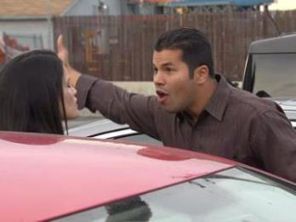
“What to do if…” Situations
Person reporting a problem to you, e.g. vehicle breakdown or injury, which may require placing yourself in a vulnerable position.
Someone threatening your safety, with or without a weapon.
Notes:
The area to secure includes from the parking lot through the corridor to the work station as well as the work assignment.
Safety may be threatened throughout this corridor. Make special provisions to maximize safety for work alone staff for arriving, reporting, working and leaving at the end of their job.

Slide 38
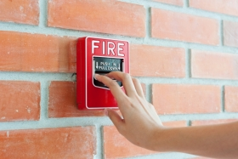
“What to do if…” Situations
Fire alarm or sprinkler system activation.
Employees can provide excellent service if nothing is taken for granted and they are thoroughly briefed on all required policies and contact information.
Notes:
Whether pulling a fire alarm box or the operation of a sprinkler system-an audible alarm will sound in-house. By its very nature, such an alarm creates a chaotic situation to have persons evacuate.
Do your people know what to do if they are working alone?
Will they check the hallway for smoke and seeing none, continue to work until conditions deteriorate?
If you have an in-house fire brigade, a better awareness may exist as to proper actions due to parallel training.

Slide 39
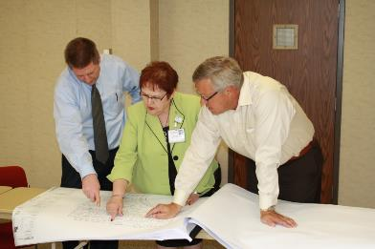
Fit Program to Staff’s Needs
Perform a job assessment
Group determines hazards, monitoring and policies
Create the plan and policies
Determine the intervals for monitoring
Notes:
Adopt or create a checklist accounting for the variety of potential hazards during your risk assessment. If equipment is involved, very often the manufacturer’s “turn-over package” for the equipment may contain checklists for maintenance as well as activation/shutdown procedures.
Have a team of multi-versed persons aid in determining hazards. Have them create a plan and policies
Determine the monitoring intervals for the lone worker
If systems change; change the policies, also updating when needed
Administer the Program and monitor its effectiveness.

Slide 40
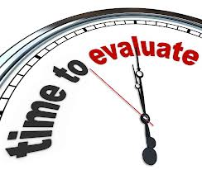
Fit Program to Staff’s Needs
At established time, review and update plan
Update plan when systems change to remain current
Administer the Program
Monitor Program’s Effectiveness
Notes:
At established time, review and update plan
Update plan when systems change to remain current
Administer the Program
Monitor Program’s Effectiveness

Slide 41
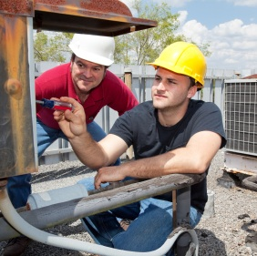
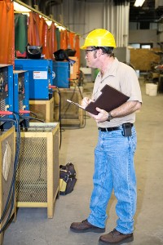
Perform Job Assessment
To determine:
PPE needs
Special circumstances that may occur
Notes:
The Job Assessment will aid in determining not only the type of PPE but the level of safety to be provided by same.
An example would be: different layering is required under Arc Flash jobs.

Slide 42
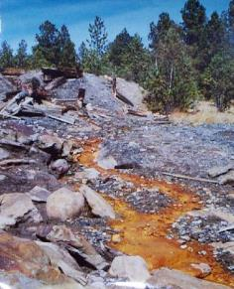
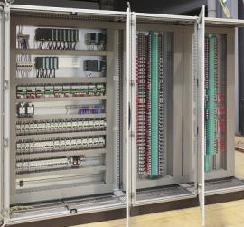
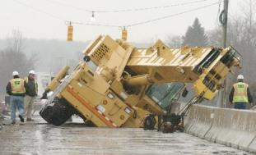
Perform Job Assessment
Risk Assessment Factors
Environment
Engineering Controls
Administrative/Work Practice Controls
Notes:
Assess the environment where the lone worker will function.
Not only chemical hazards but terrain features.
Proximate hazards or harm which may intrude into their work area.
Is wildlife active in this area which will pose a hazard?
What engineered controls are required and have they been adequately provided? Will existing roads and bridges take the strain of equipment required to do the job?
Have administrative and work practice controls accounted for foreseeable hazards created by the operation or intruding into the work area?

Slide 43
Perform Job Assessment
Determine:
Conditions
Circumstances
Interactions
People
Equipment
Environment
Possible Emergency
Situations
(Documents that can be adapted to aid you)
Notes:
So, when performing the job assessment, search-out existing documents which you may modify and add to that aiding your determination.
The Physical Security manual, although for the Army, can be a great aid due to covering personnel and physical security aspects.

Slide 44
Determine Policies
Determine hazards, monitoring and policies
Notes:
Are hard hats required in both instances?
Is fall arrest equipment required? If not required, would it be a good idea?
Does policy indicate, “No walking on top shelf to pick an order?” What other limitations are stressed to preclude an accident?

Slide 45
Create Plan/Policies
Several good sources for building your program:
Notes:
Plan and Policy creation is assisted by OSHA manuals. And, although your agency/industry may not be governed by OSHA, the adoption of OSHA recommendations is considered “Best Policy.”

Slide 46
Determine Monitoring Intervals
Determine method of monitoring.
Visual verification may be better than voice communication.
Notes:
Visual verification may be better than solely voice communication. You are not performing a security check on your lone worker. You are guaranteeing your lone worker has provisions for assist or backup. The Lone Worker wants to know they are in view should a situation arise.

Slide 47
Plan Review and Update
Establish a plan/policy and review
Update as necessary
Train all personnel who will function within the plan
Notes:
Brief all of those who will work alone on the plan and policies in effect.
Update these as needed.
Ensure each person fully understands the Plan/Policies.

Slide 48
Administer the Program
Risk Management Model
Notes:
During Program Administration, use a Risk Management Model as shown or devise your own.

Slide 49
Monitor Program Effectiveness
Notes:
After determining the effectiveness of the Program, constantly monitor/audit.
Keep the Plan and Policies current to meet changing needs.

Slide 50
Working from Home Safely
Employees who work from home can face hazards that other employees may not face.
One of these hazards being the individual may be working alone.
It is important that those working from home understand they have a responsibility to ensure their environment is safe and hazard free.
Employees who work from home should take into consideration the following hazards: fires, trips and falls, lighting, ergonomic issues, and home chemical storage.
Notes:
Any employees working from home face hazards other than just being alone. Employers should consider having a “telecommuter safety agreement” in place to ensure those employees have a safe working environment just as they should in the employer’s physical workplace.

Slide 51
Working from Home Safely-General
When working from home consider the following:
Is the workplace away from noise, distractions and devoted to the employee’s work needs?
Does the workspace accommodate a workstation, equipment and related material?
Are file drawers heavy and can they open into walkways?
Is temperature, ventilation and lighting adequate?
Is there a reliable method of communication with emergency services or the employer (landline phone or cell phone)?
Notes:
While working from home can be definite perk, an employee working from home can face different hazards that they need to be aware of and responsible for correcting.
https://www.telework.gov/federal-community/telework-employees/safety-checklist/

Slide 52
Working from Home Safely-Slips & Falls
Falls in the home injure and kill people each year:
Are floors clear and free from hazards?
Are phone lines and electrical cords secured under a desk or along a wall?
Are all stairs equipped with a handrail?
Are carpets/area rugs secured to the floor and free of frayed or worn seems?
Are loose fitting clothes being worn which can contribute to a trip and fall?
Is lighting adequate to ensure there are no areas that are very dark or difficult to see within?
Are shoes being worn? Socks can present a slip hazard.
Notes:
Falls put an employee at risk.
According to the Centers for Disease Control and Prevention (CDC):
One out of five falls causes a serious injury such as broken bones or a head injury.
Each year 3 million older people are treated in emergency departments for fall injuries.
Over 800,000 patients a year are hospitalized because of a fall injury, most often because of a head injury or hip fracture.
Employees working from home are certainly not immune to falls and therefore should check their home using the information provided on the current slide.

Slide 53
Working from Home Safely-Electrical Safety
Even 110 volts can serious injure or kill:
Check electric cords often for damage. Have damaged cords repaired right away. Worn cords can cause shock, short circuit or fire.
Pull the plastic housing of the electric plug to take it out of the wall socket; never pull on the cord.
Do not overload electric outlets with too many items plugged in at once.
Water and electricity do not mix. Do not operate electric appliances such as radios or hair dryers near a bathtub or sink full of water.
Never stick your fingers, toys or anything except electric plugs into electric outlets.
Notes:
The U.S. Consumer Product Safety Commission (CPSC) reports that electrical receptacles are involved in 5,300 fires every year, causing forty deaths and more than 100 consumer injuries.
Employees who work from home should also be aware of electrical hazards and should take the necessary steps to correct those.

Slide 54
Working from Home Safely-Electrical Safety
Are sufficient electrical outlets accessible?
Is computer equipment plugged into a surge protector?
Is equipment turned off when not in use?
Notes:
Here are some more electrical issues to consider.
https://www.telework.gov/federal-community/telework-employees/safety-checklist/

Slide 55
Working from Home Safely-Electrical Safety
Unplug any appliance that emits sparks or that does not work properly.
Always unplug an appliance before cleaning or repairing it.
Always unplug the toaster or other appliance when removing a piece of stuck food.
Remember that a turned-off appliance is still connected to electricity until it is unplugged.
Limit use of extension cords. Make sure the cord is the appropriate size for use. Some appliances or equipment require heavy-duty cords.
Notes:
Listed on the slide are additional things to take into account when considering home electrical safety.
“Home Electrical Safety” - Northern Virginia Electric Cooperative (NOVEC)

Slide 56
Working from Home Safely-Fire Safety
In a recent period U.S. fire departments responded to an average of 358,500 home fires each year:
Does the home have working smoke detectors in the workspace area as well as the rest of the home?
Is a multi-use fire extinguisher readily available and does the employee know how to use it?
Are exits, walkways and aisles unobstructed?
Is the workplace free of trash, clutter and flammables?
All radiators and portable heaters located away from flammable/combustible items?
Is there an evacuation plan in case of a fire or other emergency?
Notes:
These number of fires listed caused 12,300 civilian injuries, 2,510 civilian deaths, and $6.7 billion in direct damage.
In addition to electrical and other safety issues, employees working from home need to also be aware of what can cause a home fire whether that’s in the workspace or other parts of the home.
https://www.telework.gov/federal-community/telework-employees/safety-checklist/

Slide 57
Working from Home Safely-Ergonomics
Ergonomic issues can lead to muscloskeletal disorders (MSD’s) which can be painful:
Are the workspace chair wheels secure and the rungs and legs of the chair sturdy?
Is the chair adjustable?
Is the employee’s back supported by a backrest?
Is the employee’s feet flat on the floor or supported by a footrest?
Is there enough room at the workspace desk?
Is there sufficient light for reading/working?
Notes:
Musculoskeletal disorders (MSDs) affect the muscles, nerves, blood vessels, ligaments and tendons. *
Workers in many different industries and occupations can be exposed to risk factors at work, such as lifting heavy items, bending, reaching overhead, pushing and pulling heavy loads, working in awkward body postures and performing the same or similar tasks repetitively. Exposure to these known risk factors for MSDs increases a worker's risk of injury.*
“Ergonomics” - OSHA
https://www.telework.gov/federal-community/telework-employees/safety-checklist/

Slide 58
Working from Home Safely-Ergonomics
Is the computer screen free from noticeable glare?
Is the top of the screen at eye level?
Is there space to rest the arms while not keying?
Are the employees arms and legs at a 90 degree angle while using the computer?
Is the telephone close by so the employee does not have to reach for it?
Notes:
There are other considerations when determining ergonomic issues within a home workspace or the home in general.
https://www.telework.gov/federal-community/telework-employees/safety-checklist/

Slide 59
Working from Home Safely-Ergonomics
Are heavy items stored between the top of the knee and shoulder?
When lifting is there any bending at the waist instead of the knees?
When carrying items is visibility maintained?
After lifting are items kept close to the body?
Can a secure grip be maintained?
Notes:
Here are some additional items to consider when thinking about ergonomic issues.
https://www.telework.gov/federal-community/telework-employees/safety-checklist/

Slide 60
Working from Home Safely-Lighting
Are work areas, kitchen counters, desks, workbenches, garages, laundry rooms and basements well-lit?
Are outlet and switch covers in good condition so no wiring is exposed?
Are outlet or switch plate hot to the touch? If they are this can indicate an unsafe wiring condition.
Is there discoloration present at/above switch plates or outlets? This can indicate a potentially dangerous heat buildup at these connections.
Do any light switches work intermittently? This can indicate loose wiring or an internally cracked device.
Notes:
Lighting is a very important part of safety within a home workspace and the home totally. Dark areas can lead to trip and fall issues as well as damage to equipment if putting something down or picking it up.
Lighting can also cause a fire if the bulb is the incandescent type and is too close to combustible materials due to heat generated.
“Make Safe Lighting a Fixture of the Home” - National Electrical Manufacturers Association (NEMA)

Slide 61
Working from Home Safely-Lighting
Make sure all lamps and light fixtures are certified by a nationally recognized testing laboratory, such as Underwriters Laboratories (UL), Canadian Standards Association (CSA), or Intertek (ETL).
Always use a bulb of the correct type and wattage.
If you do not know the correct wattage, contact the manufacturer of the lamp or fixture. A bulb with excessive wattage may overheat and cause a fire.
Install bulbs with extended lifespans in hard-to-reach locations to limit the number of times you have to climb a ladder, move furniture, or engage in potentially dangerous activities.
Notes:
Listed in this slide are additional considerations regarding home/workspace lighting.
“Make Safe Lighting a Fixture of the Home” - National Electrical Manufacturers Association (NEMA)

Slide 62
Working from Home Safely-Lighting
Read and follow manufacturers’ safety instructions for fixtures, lamps, and light bulbs.
Make sure bulbs are screwed in securely. Loose bulbs may overheat.
Do not allow children to operate lamps or nightlights.
Notes:
And finally, here are other considerations for home/workspace lighting safety.
“Make Safe Lighting a Fixture of the Home” - National Electrical Manufacturers Association (NEMA)

Slide 63
Working from Home Safely-Chemicals
Read the warning label. Be sure to understand and follow what it says on how to use the product safely, how to protect yourself when using it and how to properly store it. The manufacturer's contact information always is on the label if more information is needed.
More is not better, just more dangerous. Use all chemicals sparingly in the home.
Don't take the hazardous chemical out of the original container and place it in something else, such as an old plastic milk jug or an empty liter soda bottle.
After using, immediately wash hands - or any other part of the body that may have come into direct contact with the substance - with warm soapy water.
Notes:
There are many different types of chemicals contained in products used in the home, whether those products are cleaning agents, paints, or other items. It is important for employees working from home to release that even though certain products are “on the market” it doesn’t mean they are not hazardous if used improperly or over-exposure occurs.
Information provided on the slide is taken from the American Society for Safety Engineers (ASSE).

Slide 64
Working from Home Safely-Chemicals
Follow safety recommendations when using hazardous substances.
Properly ventilate the area by turning on the fan and opening the windows. If recommended, wear gloves, long sleeves and masks.
Don't leave chemical products unattended. If you must leave the room in the middle of a task, either put the product away or take it with you.
Keep all hazardous chemicals out of the reach of young children or locked up. Properly mark and store under lock and key all household and pool chemicals, paints and poisons.
Keep these on a high shelf, out of children's reach.
Dispose of household and chemical products that are leaking, expired or look bad.
Notes:
This slide lists additional considerations regarding hazardous products.
Information provided on the slide is taken from the American Society for Safety Engineers (ASSE).

Slide 65
Working from Home Safely-Chemicals
Post the poison control center number near every phone - in the United States it is (800) 222-1222.
Never store hazardous chemicals near food or food products.
Keep hazardous chemicals away from items used to prepare and cook foods in, such as pans and silverware.
Never contaminate pots, pans and cooking utensils with a hazardous substance.
It is dangerous to combine two common household cleaners - chlorine bleach and ammonia. It forms a highly toxic gas, which has caused serious respiratory injury and even some deaths.
Notes:
Finally, here are more items to consider when thinking abou hazardous household products.
Information provided on the slide is taken from the American Society for Safety Engineers (ASSE).

Slide 66
Your Thoughts . . .
What potential safety hazards do you see?
How would you make the situation safer?
Notes:
Some answers:
What hazards exist due to working at elevated heights?
Is fall arrest equipment required?
What are the assigned duties of the lone worker?
Were others required to set-up scaffolding?
Is the safety of scaffolding checked by supervision before turn-over to lone worker?

Slide 67
Your Thoughts . . .
What potential safety hazards do you see?
How would you make the situation safer?
Notes:
Some answers:
Fall arrest equipment required (definitely on picture on the right)? When working above 4 feet in general industry, 5 feet in maritime and 6 feet in construction).
Face mask to protect against overspray (picture on the left)?
Ergonomic issues?
Although unsupervised, will periodic checks be required to determine quality of work?
Is the lone worker able to set-up and remove ladders (picture on the left)?

Slide 68
Your Thoughts . . .
What potential safety hazards do you see?
How would you make the situation safer?
Notes:
Some answers:
Is lifting a hazard – heavy, awkward, etc.?
Is worker lifting properly?
Could a lifting device make job easier?
Is PPE is required?

Slide 69
Your Thoughts . . .
What potential safety hazards do you see?
How would you make the situation safer?
Notes:
Some answers:
Does the job have a need for additional persons for lifting or is there equipment to assist?
What is the possibility of this or other duties resulting in injury?
Can medical assist arrive in a timely manner?
Does lone worker possess necessary PPE? Hard hat-yes. Are safety shoes needed? Eye protection?

Slide 70
Your Thoughts . . .
What potential safety hazards do you see?
How would you make the situation safer?
Notes:
This picture shows two overloaded “power taps/power strips.” This can frequently happen in the home environment if the person working from home is not diligent ensuring they are observing electrical safety practices.
Power taps/strips were originally designed to be used for “peripheral equipment” such as computers, printers, etc. They were not designed to be used for devices that can draw a great deal of electricity such as a microwave.
Even though power taps/strips may have a “breaker switch” which is supposed to cut power to the tap/strip, these switches may malfunction and a fire can start.
Individuals should ensure

Slide 71
Your Thoughts . . .
What potential safety hazards do you see?
How would you make the situation safer?
Notes:
This picture shows a rug that is not anchored in place which could contribute to a trip and fall issue. Individuals working at home should ensure they are looking at different items that can cause a slip and fall whether it be to themselves or others who are in the home.

Slide 72
Your Thoughts . . .
What potential safety hazards do you see?
How would you make the situation safer?
Notes:
In this picture there is combustible material too close to the burners on the stove (a towel/cloth). The individual working from home should ensure anything combustible is kept away from burners whether those burners are open flame type or electrically powered.
Additionally, it looks like there are glass jars on a shelf above the stove – is the shelf wide enough so that the no part of the jar is resting off the shelf which could result in the jar falling.

Slide 73
Your Thoughts . . .
What potential safety hazards do you see?
How would you make the situation safer?
Notes:
Some answers:
Unarmed patrol should have armed backup response.
Determine strenuous activities required and limitations of those doing the job; not only medical but check-in on periodic basis and when stopping vehicle and getting out to interact with public.

Slide 74
Your Thoughts . . .
What potential safety hazards do you see?
How would you make the situation safer?
Notes:
Some answers:
Repaint directional lines
Reinforce with direction signage
Facility map to indicate relationship of parking lot to main buildings
Security patrol daytime and evenings
Seasonal considerations: snow and ice removal

Slide 75
Your Thoughts . . .
What potential safety hazards do you see?
How would you make the situation safer?
Notes:
Some answers:
Briefing on route concerning existing hazards now snow-covered
Radio contact; frequencies
Passenger to observe
Rest period requirements
Rehydration ability

Slide 76
Your Thoughts . . .
What potential safety hazards do you see?
How would you make the situation safer?
Notes:
Some answers:
Knowing where their Mother is and if she’s coming after you!
PPE
Rabies may be a possibility as well as ticks which may be on Raccoons
Cuts, scrapes, scratches and spread of infection
Do you really want to bring your work home with you?

Slide 77
Summary
Control measures are based on the hazard assessment and targeted toward obtaining emergency help when needed.
Some control measures include:
Buddy System
Personal Check
Periodic Telephone Contact
Electronic Communication/Surveillance
Central Monitoring
Shutdown and Isolation Measures
“What To Do If…” Situations
Notes:
In summary:
Determine the hazards then craft the control measures to take into account those variables which may effect the safety of the lone worker.

Slide 78
Bibliography
“Recommendations for Workplace Violence Prevention Programs in Late Night Retail Establishments,” OSHA, OSHA 3153-12R, 2009
“Guidelines for Preventing Workplace Violence for Health Care and Social Service Workers,” OSHA, OSHA 3148-01R, 2004
FM3-19.30 Physical Security, Headquarters, Department of the Army, Washington, DC, January 2001. (Supersedes FM 19-30, 1 March 1979)

Slide 79
Bibliography (Con’t.)
www.worksafe.vic.gov.au Article, May, 2014
www.hsa.ie/eng/Topics/Hazards/Lone_Workers
Article, May 2014

Slide 80
Contact Information
To contact a Health & Safety Training Specialist:
Bureau of Workers’ Compensation
1171 South Cameron Street Room 324
Harrisburg, PA 17104-2501
717-772-1635
RA-LI-BWC-paths@pa.gov
PPT-079-02
80

Slide 81
Contact Information
Health & Safety Training Specialists
(717) 772-1635
RA-LI-BWC-PATHS@pa.gov

Slide 82
Questions

Slide 83
IUP OSHA Consultation Program
Telephone Number 1-800-382-1241
Notes:
Since 1983, the Safety Sciences Department of Indiana University of Pennsylvania has been the officially designated agency in the Commonwealth of Pennsylvania for providing FREE occupational and health consultative services made available through federal regulations.
The program is designed to assist private-sector employers in the commonwealth in understanding and voluntarily complying with applicable safety/health regulations enforced by the federal Occupational Safety and Health Administration.
This program was designed to assist small business employers with 500 or less employees, however program representatives are able to answer OSHA related questions.

Slide 84
PennOSHS Program

