Slide 1
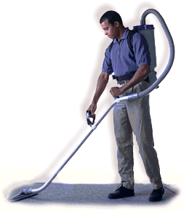
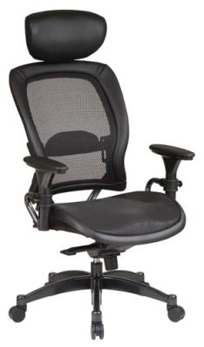
ERGONOMICS
Bureau of Workers’ Compensation
PA Training for Health & Safety (PATHS)
Notes:
Ergonomics can be defined as the study of workplace design; the study of how a workplace and the equipment used there can best be designed for comfort, efficiency, safety, and productivity.
It is also defined as the design of workplace or equipment: those factors or qualities in the design of something, especially a workplace or equipment used by people at work, that contribute to comfort, efficiency, safety, and ease of use.

Slide 2
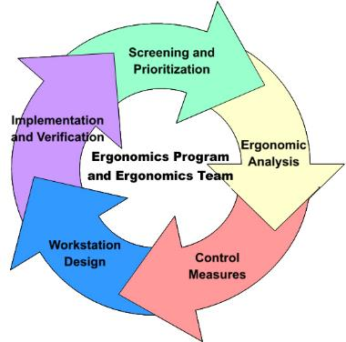
Topics
Hazard Identification
Musculoskeletal Disorders
Effects of Cold, Noise & Lighting
Life Factors
Engineering & Administrative Controls
Notes:
Topics of discussion will include:
What is Ergonomics and how do you identify hazards in the workplace
Musculoskeletal Disorders including risk factors and prevention
Ergonomic Tools
Effects of cold environments
Effects of noise and lighting on Ergonomics
Life factors including exercise, smoking and medication
Engineering & Administrative controls
Recommended exercises.

Slide 3
What is Ergonomics?
Ergonomics: The science of fitting jobs to people. Encompasses the body of knowledge about physical abilities and limitations as well as other human characteristics relevant to job design.
Ergonomic design: The application of this body of knowledge to the design of the workplace (tasks, equipment, environment) for safe and efficient worker use.
Good ergonomic design: Makes the most efficient use of worker capabilities while ensuring job demands do not exceed those capabilities.
Notes:
Ergonomics: is the science of fitting jobs to people. It encompasses the body of knowledge about physical abilities and limitations as well as other human characteristics relevant to job design.

Slide 4
Musculoskeletal Disorders
Musculoskeletal disorders (MSD’s) are injuries or illnesses to soft body tissue such as:
Muscles
Nerves
Tendons
Ligaments
Joints
Cartilage
Spinal Discs
Notes:
Ergonomics looks at potential results of faulty systems and activities which may result in Musculoskeletal disorders. MSD’s are injuries or illnesses to soft body tissue such as:
Muscles
Nerves
Tendons
Ligaments
Joints
Cartilage
Spinal Discs

Slide 5
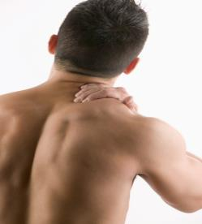
Musculoskeletal Disorders
MSD’s do not include injuries caused by slips, trips, falls, or other similar accidents.
MSD’s can differ in severity from mild periodic symptoms to severe chronic and debilitating conditions.
Notes:
Musculoskeletal disorders do NOT include injuries caused by slips, trips, falls, or other similar accidents.
MSD’s can differ in severity from mild periodic symptoms to severe chronic and debilitating conditions.

Slide 6

MSDs – Signs & Symptoms
• Aching
• Burning
• Cramping
• Loss of Color
• Numbness
Notes:
Some of the signs and symptoms of MSD’s would include:
Aching
Burning
Cramping
Loss of Color
Numbness

Slide 7
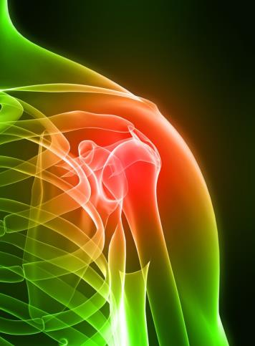
MSDs – Signs & Symptoms
• Pain
• Swelling
• Stiffness
• Tingling
• Weakness
Notes:
Depending upon the cause of the MSD, such as repetition, turning, lifting or over-extending, further symptoms may be found as:
Pain
Swelling
Stiffness
Tingling
weakness

Slide 8
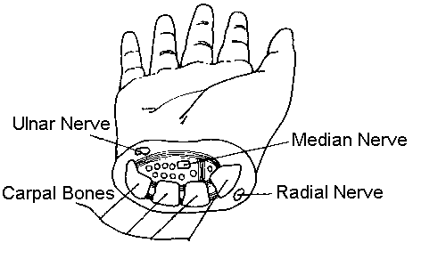
MSDs-Carpal Tunnel
Carpal Tunnel – a tunnel in the wrist through which the median nerve and nine digital flexor tendons pass.
Formed by the wrist bones and a dense trans-carpal ligament.
Continued and repetitive pressure on the median nerve in the carpal tunnel can cause Carpal Tunnel Syndrome (CTS).
Notes:
Carpal Tunnel is a tunnel in the wrist through which the median nerve and nine digital flexor tendons pass.
Formed by the wrist bones and a dense trans-carpal ligament.
Continued and repetitive pressure on the median nerve in the carpal tunnel can cause Carpal Tunnel Syndrome (CTS)

Slide 9
MSDs-Prevention of CTS
If you do the same tasks with your hands over and over, try not to bend, extend, or twist your hands for long periods.
Don’t work with your arms too close or too far from your body.
Don’t rest your wrists on hard surfaces for long periods.
Switch hands during work tasks if possible.
Notes:
You may be able to prevent Carpal Tunnel Syndrome in a variety of ways.
If you do the same tasks with your hands over and over, try not to bend, extend, or twist your hands for long periods.
Don’t work with your arms too close or too far from your body.
Don’t rest your wrists on hard surfaces for long periods.
Switch hands during work tasks if possible.

Slide 10
MSDs-Prevention of CTS
Take regular breaks from repeated hand
movements to give your hands and wrists time
to rest.
Don’t sit or stand in the same position all day.
Adjust your chair so your forearms are level with
your keyboard and you don’t flex your wrists to
type.
Notes:
CTS prevention also includes:
Take regular breaks from repeated hand movements to give your hands and wrists time to rest.
Don’t sit or stand in the same position all day.
Adjust your chair so your forearms are level with your keyboard and you don’t flex your wrists to type.

Slide 11
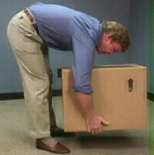
MSDs-Back Injuries
Heavy lifting from above the shoulders.
Heavy lifting from below the knees.
Twisting while lifting/carrying.
Bending over at the waist.
→ → → → → → → → →
Carrying objects to one side.
Notes:
Common causes of back injuries include:
Heavy lifting from above the shoulders.
Heavy lifting from below the knees.
Twisting while lifting/carrying.
Bending over at the waist.
Carrying objects to one side.

Slide 12
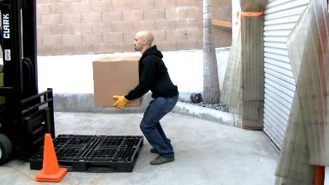
MSDs-Protect Your Back
Lifting
Avoid bending at the waist.
Squat down with your back straight & knees bent.
Grasp the object.
Bring it close to your body.
Slowly rise.
Let your thigh muscles do the lifting.
Notes:
During your normal duties, you must protect your back. When lifting:
Avoid bending at the waist.
Squat down with your back straight & knees bent.
Grasp the object.
Bring it close to your body.
Slowly rise.
Let your thigh muscles do the lifting.

Slide 13
MSDs-Protect Your Back
Standing
Shift your weight slightly
Use proper footwear with cushioned insoles
Avoid high heels
Proper posture when standing =
→ Shoulders not rolled forward
→ Stomach area pulled in
→ Small of the back straight
→ Hips not tilted
Notes:
Some jobs have a period of extended standing. If such is the case with your job:
Shift your weight slightly.
Use proper footwear with cushioned insoles.
Avoid high heels.
Assume proper posture when standing which would be:
→ Shoulders not rolled forward
→ Stomach area pulled in
→ Small of the back straight
→ Hips not tilted
This will more evenly distribute your weight and not cause strain on one particular body part.

Slide 14
Sitting Posture
Sit close to your desk so you don’t have to bend forward.
If you do bend, bend from your hips.
Position your work or chair so you can look forward rather than down.
Use a document holder or move your computer screen so the top of it is at eye level.
Shift your position frequently to prevent strain.
Take a break or do stretching exercises.
Notes:
Sitting posture also includes:
Sit close to your desk so you don’t have to bend forward.
If you do bend, bend from your hips.
Position your work or chair so you can look forward rather than down.
Use a document holder or move your computer screen so the top of it is at eye level.
Shift your position frequently to prevent strain.
Take a break or do stretching exercises.

Slide 15
Sitting
Use a straight chair with support for your lower spinal curve.
Use a small cushion or rolled up towel behind your back to maintain the proper curve.
Check the seat’s height.
Adjust your seat so that your knees are equal with or slightly lower than your hips.
If the seat’s height is not adjustable use a footrest if necessary.
Keep your feet flat; avoid crossing your legs.
Keep your ankles and elbows at right angles.
Notes:
Most office staff are at work stations sitting most of the day. To reduce this condition from causing MSD, try the following:
Use a straight chair with support for your lower spinal curve.
Use a small cushion or rolled up towel behind the small of your back to maintain the proper curve.
Check the seat’s height.
Adjust your seat so your knees are equal with or slightly lower than your hips.
If the seat’s height is not adjustable use a footrest if necessary to elevate your feet.
Keep your feet flat; avoid crossing your legs.
Keep your ankles and elbows at right angles.

Slide 16
MSDs-Joint Disorders
Joints involve many structures, including
tendons, muscles, nerves, and bones.
Inflammation may be caused by joint
damage or repetitive heavy use.
With inadequate repair, cartilage thinning
may lead to osteoarthritis.
Notes:
Joint disorders may also occur.
► Joints involve many structures, including tendons, muscles, nerves, and bones.
► Inflammation may be caused by joint damage or repetitive heavy use.
► With inadequate repair, cartilage thinning may lead to osteoarthritis. (Osteoarthritis is the degeneration of joint cartilage and the underlying bone that causes pain and stiffness).

Slide 17
MSDs-Joint Disorders
Work tasks that may be associated with lower-
extremity joint loading: Repetitive/prolonged
stair or ladder climbing, kneeling, squatting,
standing, carrying heavy loads, jumping.
Mechanical stresses associated with certain tasks
can cause degenerative joint disease.
Degenerative joint disease can occur even after
relatively low loads on joints if the forces are
applied impulsively and repetitively.
Notes:
Joint disorders can result from various tasks.
►Work tasks that may be associated with lower-extremity joint loading. Repetitive/prolonged stair or ladder climbing, kneeling, squatting, standing, carrying heavy loads or jumping may also contribute.
►Mechanical stresses associated with certain tasks can cause degenerative joint disease.
►Degenerative joint disease can occur even after relatively low loads on joints if the forces are applied impulsively and repetitively.

Slide 18
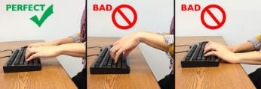

MSD Risk Factors-Avoid:
• Bent wrists
• Twisting at the waist
• Rolled shoulders
• Leaning forward
• Bending at the waist
Notes:
Some of the risk factors to avoid:
Bent wrists
Twisting at the waist
Rolled shoulders
Leaning forward
Bending at the waist

Slide 19
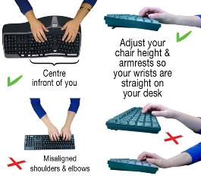
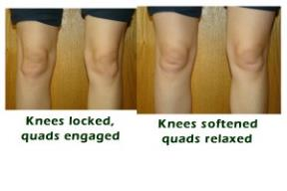
MSD Risk Factors-Avoid:
Avoid:
Winged elbows
Overreaching
Stepping backwards
Locking your knees
Notes:
Avoid:
Winged elbows
Overreaching
Stepping backwards
Locking your knees

Slide 20
MSD Risk Factors-Prevention
Lifting
Place heavier material above the knees and
below shoulder height
Use team lifting
Use mechanical devices such as tool supports,
platforms lifts, barrel lifts, air lifts, and hoists
Moving
Lower required force by using carts, trolleys,
pallet jacks, conveyors and tracked lifts
Notes:
Preventive methods can be applied to various routines.
Lifting
Place heavier material above the knees and below shoulder height
Use team lifting when required
Use mechanical lifting devices such as tool supports, platforms lifts, barrel lifts, air lifts, and hoists
Moving
Lower the required force by using carts, trolleys, pallet jacks, conveyors and tracked lifts

Slide 21
MSD Risks-Pressure
Hazards = Damage to Nerves & Blood Vessels
• External Compression – sharp edges concentrate
forces on a small area of the anatomy resulting in
high, localized pressure.
• Internal Compression – nerves, vessels, and
other soft tissues may be internally compressed
under conditions of:
◦ High-force exertions
◦ Awkward postures
◦ Static postures
◦ Swelling of injured tissue
◦ High velocity or acceleration of movement
Notes:
Pressure, both external compression and internal compression can damage nerves and blood vessels.
External Compression – sharp edges concentrate forces on a small area of the anatomy resulting in
high, localized pressure.
Internal Compression – nerves, vessels, and other soft tissues may be internally compressed under conditions of:
High-force exertions
Awkward postures
Static postures
Swelling of injured tissue
High velocity or acceleration of movement

Slide 22

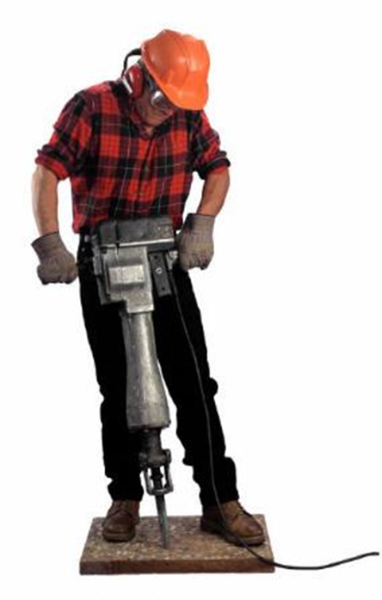

MSD Risks
Cold
Noise
Lighting
Notes:
COLD:
Cold environments compromise muscle efficiency.
Possible vascular and neurological damage.
Workers with cold-desensitized fingers may grasp loads with more force than necessary: exposes muscles, soft tissues, and joints to increased force.
Alcohol, nicotine, caffeine, and some medication increases MSD risks from cold temperatures
NOISE:
Increased muscle tension
Quicker onset of fatigue
Mental stress
Reduced concentration
Diverted attention
Slower recovery time
LIGHTING (Not enough or too much):
Awkward postures
Muscle fatigue
Eye strain
Mental fatigue

Slide 23



Life Factors
Exercise:
• Improved health & Stronger body
• Improved endurance & Reduced stress
• Better range of motion
Smoking:
Restricts blood vessels & Carbon Monoxide in blood
Longer recover time from injury
Poor general health
Medication:
Could raise or lower blood pressure
Could mask pain
Could affect eyesight
Notes:
Certain life factors can help limit or reduce MSD, one being proper exercise.
Proper exercise means:
• Improved health
• Stronger body
• Improved endurance
• Reduced stress
• Better range of motion

Slide 24
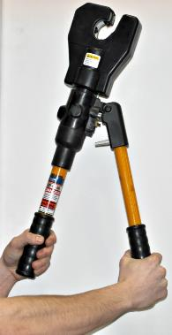
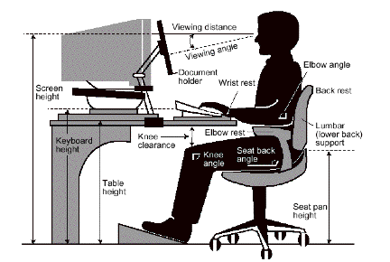
Ergonomic Controls-Engineering
Engineering controls include changing, modifying or redesigning of:
• Workstations
• Tools
• Facilities
• Equipment
• Materials
• Processes
Notes:
Engineering controls can aid in MSD reduction.
Engineering controls include changing, modifying or redesigning:
Workstations
Tools
Facilities
Equipment
Materials
Processes

Slide 25
Ergonomic Controls-Administrative
Administrative controls = procedures and methods that significantly reduce daily exposure to WMSD hazards by altering the way in which work is performed.
Examples:
• Employee Rotation
• Job Task Enlargement
• Adjustment of work place
• Redesign of work methods
• Alternative Tasks
• Rest Breaks
Notes:
Administrative controls are procedures and methods that significantly reduce daily exposure to WMSD hazards by altering the way in which work is performed.
Examples:
Employee Rotation
Job Task Enlargement
Adjustment of work place
Redesign of work methods
Alternative Tasks
Rest Breaks

Slide 26
Prevent, Prevent, Prevent
The bottom line: prevent accidents and injuries from occurring!
Ensuring your workstation is ergonomically designed is one method to prevent injuries.
All employees need to have a basic understanding of ergonomics, and should report any ergonomic hazards to their Supervisor immediately.
Notes:
When it comes to discussing MSD and CTS, the main mission is Prevention
The bottom line: prevent accidents and injuries from occurring!
Ensure your workstation is ergonomically designed to prevent injuries.
Provide all employees with a basic understanding of ergonomics, and have them report any ergonomic hazards to their Supervisor immediately.

Slide 27
Review
Repetitive motion tasks can lead to Musculo-Skeletal Disorders (MSD’s).
Maintain correct posture while sitting, standing and walking.
Stretch to “limber up” muscles before and after work.
Take regular breaks.
Notes:
Remember:
Repetitive motion tasks can lead to Musculoskeletal Disorders (MSD’s).
Maintain correct posture while sitting, standing and walking.
Stretch to “limber up” muscles before and after work.
Take regular breaks.

Slide 28
Review
Exercise regularly.
Ensure your workstation is set up ergonomically correct for you.
Ensure lighting in your work area is adequate.
Report ergonomic hazards or symptoms to your Supervisor.
Notes:
Also remember:
Exercise regularly.
Ensure your workstation is set up ergonomically correct for you.
Ensure lighting in your work area is adequate.
Report ergonomic hazards or symptoms to your Supervisor.

Slide 29

Contact Information
Health & Safety Training Specialists
1171 South Cameron Street, Room 324
Harrisburg, PA 17104-2501
(717) 772-1635
RA-LI-BWC-PATHS@pa.gov

Slide 30
Questions

