Slide 1
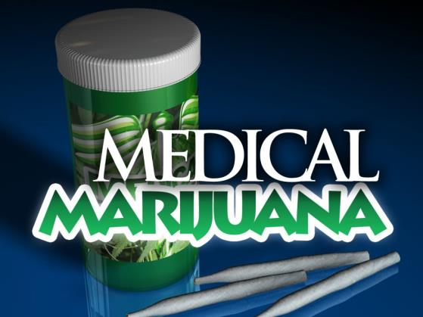
Medical Marijuana
Bureau of Workers’ Compensation
PA Training for Health & Safety (PATHS)
Notes:
Medical marijuana uses the marijuana plant or chemicals in it to treat diseases or conditions. It's basically the same product as recreational marijuana, but it's taken for medical purposes.
The marijuana plant contains more than 100 different chemicals called cannabinoids. Each one has a different effect on the body.
The side effects of medical marijuana are minimal when used at low doses and include dry mouth and fatigue. At higher doses, side effects include dizziness, paranoia, and psychoactive effects.

Slide 2

Marijuana
Recreational marijuana is legal in 16 states and D.C.—not including PA.
Medical marijuana is legal in 36 states—including PA—and D.C.
Under federal law, marijuana remains a Schedule I controlled substance.
Under federal law it is considered to have no medicinal value. Cannot be prescribed, possessed or sold.
THC–produces the “high,” and medical marijuana is legal in PA with a doctor’s recommendation.
Notes:
Recreational marijuana is legal in 16 states and D.C.—not including PA.
Medical marijuana is currently legal in 36 states and D.C. despite the federal ban on the substance.
The U.S. Drug Enforcement Administration lists marijuana as a Schedule I controlled substance.
Schedule I drugs are defined as drugs with no currently accepted medical use and a high potential for abuse (Examples: Heroin, LSD and Ecstasy).
A listing of drugs and their classification schedules are located in the Controlled Substance Act (1970).
Whole or crude marijuana (including marijuana oil or hemp oil) is not approved by the U.S. Food and Drug Administration (FDA) for any medical use.
Marijuana cannot legally be prescribed, possessed, or sold under federal law.
Despite a federal ban, many states allow use of medical marijuana to treat pain, nausea and other symptoms.
Federal law regulating marijuana supersedes state law. Because of the discrepancy between state and federal laws, people may still be arrested and charged with possession in states where marijuana for medical use is legal.
http://www.mayoclinic.org/healthy-lifestyle/consumer-health/in-depth/medical-marijuana/art-20137855?pg=2
Picture: growingmarijuanatips.com

Slide 3
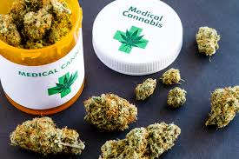
Topics
Tetrahydrocannabinol (THC) and Cannabidiol (CBD)
Common side effects and possible risks
Medical Benefits
Serious Medical Conditions
Federal and state laws
Safety sensitive positions
What Employers Need to Know and Proactive Actions
Notes:
Here are the topics we will discuss in today’s presentation. (Review topics)

Slide 4
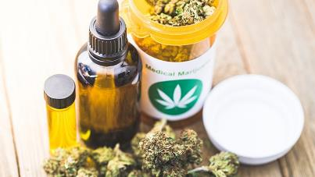
Topics
Employer Drug/Alcohol Policy
Workplace drug testing
Employers’ vs. Workers’ rights
Predictors of what’s to come
Effects on job safety
Marijuana use results
Legal facts

Slide 5

Objectives
Understand and define the distinction between marijuana and “medical marijuana.”
Describe various serious medical conditions when medical marijuana is used.
Notes:
Objectives:
Understand and define the distinction between marijuana and “medical marijuana.”
Describe various conditions when medical marijuana is used.
Describe some of the precautions for use and symptoms or conditions which may be aggravated by such use.

Slide 6
Objectives continued…
Understand the company’s need to develop a drug policy to include punitive actions for those under the influence of medical marijuana.
Implement the company drug policy to ensure equitable enforcement, as well as safety for medical marijuana users, and their coworkers.
Notes:
Objectives:
Understand the company’s need to develop a drug policy to include punitive actions for those under the influence of medical marijuana.
Implement the company drug policy to ensure equitable enforcement as well as safety for medical marijuana users and their coworkers.

Slide 7
Marijuana
Name given to the dried buds and leaves of varieties of the cannabis sativa plant.
Also called pot, grass, cannabis, weed, hemp, hash, marihuana, ganja, and dozens of others.
Marijuana has been used in herbal remedies for centuries.
Notes:
Marijuana
Name given to the dried buds and leaves of varieties of the cannabis sativa plant.
Also called pot, grass, cannabis, weed, hemp, hash, marihuana, ganja, and dozens of others.
Marijuana has been used in herbal remedies for centuries.
Prior to the Marijuana Tax Act of 1937, which banned marijuana use and sales, cannabis had enjoyed a 5000-year history as a therapeutic agent across many cultures.
http://www.cancer.org/treatment/treatmentsandsideeffects/physicalsideeffects/chemotherapyeffects/marijuana-and-cancer

Slide 8

Marijuana
Scientists have identified many biologically active components in marijuana. These are called cannabinoids.
The two best studied components are the chemicals delta-9-tetrahydrocannabinol (THC), and cannabidiol (CBD).
Notes:
Scientists have identified many biologically active components in marijuana. These are called cannabinoids.
The two best studied components are the chemicals delta-9-tetrahydrocannabinol (THC), and cannabidiol (CBD).
Note: THC is the primary psychoactive compound in cannabis. A psychoactive drug is a chemical substance that changes brain function and results in alterations in perception, mood, consciousness, cognition or behavior. Cannabidiol is a non-psychoactive compound and does not have the intoxicating effects like those caused by THC.
http://www.cancer.org/treatment/treatmentsandsideeffects/physicalsideeffects/chemotherapyeffects/marijuana-and-cancer

Slide 9
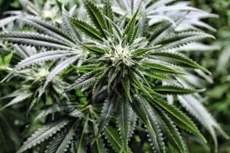
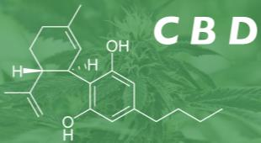
Marijuana
THC seems to cause the reported “high” and also can help relieve pain and nausea, reduce inflammation, and act as an antioxidant. It can also lead to feelings of anxiety and paranoia.
Cannabidiol (CBD) helps treat seizures, reduce anxiety and paranoia, and can counteract the “high” caused by THC.
Notes:
Different cultivars (strains or types) and even different crops of marijuana plants can have varying amounts of these and other active compounds. This means that marijuana can have different effects based on the strain used. Both THC and CBD interact with your endocannabinoid system (ECS) to regulate various functions in your body such as: Appetite, Pain, Memory, Mood, Sleep, Immune Response and Cycles of cellular life and death.
Your ECS is a large cell receptor proteins network with a wide range of functions. You have receptors throughout your body, such as in your central nervous system, digestive tract, skin and reproductive organs.
Although it’s well-known that THC causes you to feel “high,” many patients value CBD for its medical and non-psychoactive effects. THC produces the mind-altering, euphoric effects of the plant. This is because THC binds to your cannabinoid 1 (CB1) receptors found in your brain and changes how it functions — leading to the “high” feeling. CBD doesn’t bind to your CB1 receptors. Therefore, it doesn’t produce the same psychoactive effects THC does. But CBD does affect the physiology of your brain and body. Studies show CBD could work as an antipsychotic and a mild antidepressant because of the way it interacts with your brain’s relevant receptors. Researchers also found CBD functions in over 60 various molecular pathways.
According to some studies, THC has “cancer-killing” properties. Trials show CBD has a potent anti-tumor effect. CBD slows down the progression of certain cancers like lung, breast, colon and prostate cancer.
https://www.cancer.org/treatment/treatments-and-side-effects/complementary-and-alternative-medicine/marijuana-and-cancer.html
https://www.marijuanadoctors.com/resources/cbd-vs-thc/
Picture: coloradopain.com/hemphoneyliquid.com

Slide 10
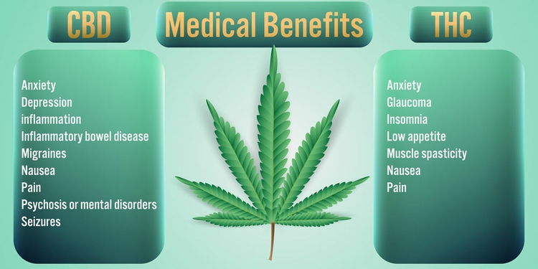
Marijuana
Notes:
In a recent study titled, “The Association between Cannabis Product Characteristics and Symptom Relief,” published in the journal Scientific Reports, University of New Mexico researchers found that THC and CBD contents were the most important factor for optimizing symptom relief for a wide variety of health conditions.
This slide shows the Medical Benefits of CBD and THC and how each provides relief for some common health conditions.
https://news.unm.edu/news/notorious-psychoactive-chemical-thc-more-important-for-therapeutic-effects-in-cannabis-than-previously-believed

Slide 11

How Marijuana Affects the Brain
THC, a key ingredient in marijuana, attaches to cannabinoid receptors throughout the body. Several areas of the brain
have high densities of these receptors, which helps explain
the different effects of the drug.
Cerebral cortex plays a role in memory, thinking perceptual awareness and consciousness. With marijuana use an altered consciousness; perceptual distortions; memory impairment; occasional delusions, and hallucinations may occur.
Hypothalamus governs metabolic processes such as appetite. Increased appetite is common.
Brain stem controls many basic functions including arousal,
the vomiting reflex, blood pressure, and heart rate. Nausea
relief; rapid heart rate; reduced blood pressure; downiness.
Hippocampus is key to memory storage and recall. Impairment
in memory may occur.
Cerebellum governs coordination and muscle control. With regular marijuana use, there is a reduced spasticity and impaired coordination.
Amygdala plays a role in emotion. Marijuana can cause anxiety and panic in some cases; reduced anxiety and blocking of traumatic memories in other cases; reduced hostility.
Notes:
How Marijuana Affects the Brain
THC, a key ingredient in marijuana, attaches to cannabinoid receptors throughout the body. Several areas of the brain have high densities of these receptors, which helps explain the different effects of the drug.
Cerebral cortex plays a role in memory, thinking perceptual awareness and consciousness. With marijuana use an altered consciousness; perceptual distortions; memory impairment; occasional delusions, and hallucinations may occur.
Hypothalamus governs metabolic processes such as appetite. Increased appetite is common.
Brain stem controls many basic functions including arousal, the vomiting reflex, blood pressure, and heart rate. Nausea
relief; rapid heart rate; reduced blood pressure; downiness.
Hippocampus is key to memory storage and recall. Impairment in memory may occur.
Cerebellum governs coordination and muscle control. With regular marijuana use, there is a reduced spasticity and impaired coordination.
Amygdala plays a role in emotion. Marijuana can cause anxiety and panic in some cases; reduced anxiety and blocking of traumatic memories in other cases; reduced hostility.
Credit: DrugFree Workplace PA

Slide 12
Common Side Effects
Altered senses (i.e. seeing brighter colors)
Altered sense of time
Changes in mood
Impaired body movement
Difficulty with thinking and problem-solving
Impaired memory
Hallucinations (when taken in high doses)
Delusions (when taken in high doses)
Psychosis (when taken in high doses)
Notes:
THC acts on specific brain cell receptors that ordinarily react to THC-like chemicals. These natural chemicals play a role in normal brain development and function.
Marijuana over-activates parts of the brain that contain the highest number of those receptors. This causes the “high” that people feel. Other effects include:
Altered senses (i.e. seeing brighter colors)
Altered sense of time
Changes in mood
Impaired body movement
Difficulty with thinking and problem-solving
Impaired memory
Hallucinations (when taken in high doses)
Delusions (when taken in high doses)
Psychosis (when taken in high doses)
Credit: DrugFree Workplace PA

Slide 13

Possible Risks
Immediate and Long-Term possible risks include:
Increased heart rate
Bloodshot eyes
Dizziness
Impaired concentration and memory
Slower reaction times
Negative drug-to-drug interactions
Notes:
Immediate and Long-Term possible risks include:
Increased heart rate
Bloodshot eyes
Dizziness
Impaired concentration and memory
Slower reaction times
Negative drug-to-drug interactions
Additional Risks:
Withdrawal symptoms
Mental illness in people with a tendency toward it
Increased risk of heart attack or stroke
Breathing problems, for people who smoke marijuana
Addiction occurs in about 10% of users who start smoking before age 25
http://www.mayoclinic.org/healthy-lifestyle/consumer-health/in-depth/medical-marijuana/art-20137855?pg=2
Picture: stockarch.com

Slide 14
Marijuana Usage
Most frequently used illicit drug of abuse in the U.S.
Most often drug detected in workplace testing.
Approximately 6.8 million adults (18 to 25 years old) 19.6% and about 13.5 million adults (26 and older) 6.6% used marijuana.
Notes:
Marijuana Usage
Most frequently used illicit drug of abuse in the U.S.
Most often drug detected in workplace testing.
Approximately 6.8 million adults (18 to 25 years old) 19.6% and about 13.5 million adults (26 and older) 6.6% used marijuana.
Christine Clearwater, president of Drug-free Solutions Group in a webinar for the National Safety Council

Slide 15
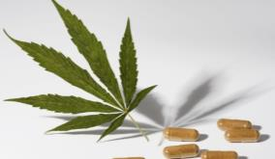
Medical Marijuana Defined
Medical marijuana is used to treat pain, nausea and other side effects of medical treatments and some disease symptoms.
It may benefit adults and children with certain serious medical conditions.
Notes:
Medical Marijuana Defined
Medical marijuana is used to treat pain, nausea and other side effects of medical treatments and some disease symptoms.
It may benefit adults and children with certain serious medical conditions.
Depending on why a person is using medical marijuana, treatment may be short term or continue for years.
http://www.mayoclinic.org/healthy-lifestyle/consumer-health/in-depth/medical-marijuana/art-20137855?pg=2
Picture: huffingtonpost.com

Slide 16

Serious Medical Conditions
A "serious medical condition" under the law is any one of the following (23 in total):
Amyotrophic lateral sclerosis;
Autism;
Cancer, including remission therapy;
Crohn's disease;
Damage to the nervous tissue of the central nervous system (brain-spinal cord) with objective neurological indication of intractable spasticity, and other associated neuropathies;
Notes:
A "serious medical condition" under the law is any one of the following:
Amyotrophic lateral sclerosis;
Autism;
Cancer, including remission therapy;
Crohn's disease;
Damage to the nervous tissue of the central nervous system (brain-spinal cord) with objective neurological indication of intractable spasticity, and other associated neuropathies;
PA Medical Marijuana Act, 35 Pa. C.S.A. Section 10231.101

Slide 17
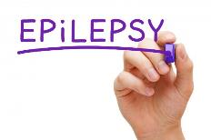

Serious Medical Conditions
Serious medical conditions continued:
Dyskinetic and spastic movement disorders;
Epilepsy
Glaucoma
HIV / AIDS;
Huntington's disease;
Inflammatory bowel disease;
Intractable seizures;
Multiple Sclerosis;
Notes:
Serious medical conditions continued:
Dyskinetic and spastic movement disorders;
Epilepsy
Glaucoma
HIV / AIDS;
Huntington's disease;
Inflammatory bowel disease;
Intractable seizures;
Multiple sclerosis;
PA Medical Marijuana Act, 35 Pa. C.S.A. Section 10231.101

Slide 18
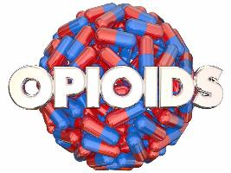
Serious Medical Conditions
Serious medical conditions continued:
Neurodegenerative diseases;
Neuropathies;
Opioid use disorder for which conventional therapeutic interventions are contraindicated or ineffective, or for which adjunctive therapy is indicated in combination with primary therapeutic interventions;
Parkinson's disease;
Notes:
Serious medical conditions continued:
Neurodegenerative diseases;
Neuropathies;
Opioid use disorder for which conventional therapeutic interventions are contraindicated or ineffective, or for which adjunctive therapy is indicated in combination with primary therapeutic interventions;
Parkinson's disease;
PA Medical Marijuana Act, 35 Pa. C.S.A. Section 10231.101

Slide 19
Serious Medical Conditions
Serious medical conditions continued:
Post-traumatic stress disorder;
Severe chronic or intractable pain of neuropathic origin or severe chronic or intractable pain;
Sickle cell anemia;
Terminal illness;
Anxiety Disorders; (Effective July 20, 2019)
Tourette Syndrome (Effective July 20, 2019)
Notes:
Serious medical conditions continued:
Post-traumatic stress disorder;
Severe chronic or intractable pain of neuropathic origin or severe chronic or intractable pain;
Sickle cell anemia;
Terminal illness;
Anxiety Disorders; (Effective July 20, 2019)
Tourette Syndrome (Effective July 20, 2019)
PA Medical Marijuana Act, 35 Pa. C.S.A. Section 10231.101

Slide 20
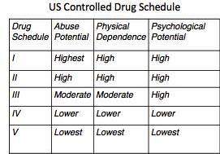
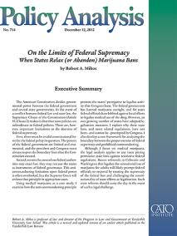
Federal Laws
Marijuana is a federally controlled substance illegal to sell, possess or use.
Now medical marijuana is legal in 36 states including PA and Washington, D.C., despite the federal ban.
The federal government has said it will not prosecute people who abide by their state’s marijuana laws.
Notes:
Because of the discrepancy between state and federal laws, people may still be arrested and charged with possession in states where marijuana for medical use is legal or when using a product not allowed in a state program.
Each state that has legalized marijuana for medical use regulates who may use it and how the product is distributed within its borders. States have processes for certifying and registering eligible people, designated dispensaries, or medical marijuana centers.
http://www.mayoclinic.org/healthy-lifestyle/consumer-health/in-depth/medical-marijuana/art-20137855?pg=2
Picture: quoteimg.com
cato.org

Slide 21
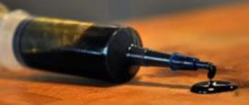
PA State Law
Medical Marijuana Program
Under Act 16 of 2016,“medical marijuana” refers to marijuana obtained for a certified medical use by a Pennsylvania resident with a serious medical condition limited by statute in Pennsylvania to the following forms:
Pill
Oil
Topical forms, including gel, creams or ointments
A form medically appropriate for administration by vaporization or nebulization (including dry leave/plant form)
Tincture
Liquid
Notes:
Governor Tom Wolf signed Senate Bill 3 into law April 17, 2016. The new law “Act 16” became effective May 17, 2016. This makes PA the 24th state to pass this type of legislation. The program is administered by the PA Department of Health. Program implementation was expected to take between 18 to 24 months. On February 15, 2018 – Medical Marijuana became available.
PA law does not permit smoking marijuana. In May 2018, dry leaf or plant form was approved for administration by vaporization.
FINAL%20Medical%20Marijuana%20FAQs%20053116.pdf
PA Bulletin: May 12, 2018
Picture: stonerdays.com

Slide 22
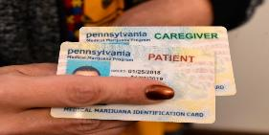
PA State Law
PA Medical Marijuana Law prescribes how a person obtains a certificate for use from their physician; how the physician obtains the ability to issue such certificates.
Medical marijuana is a physician recommended legal medication for the treatment of a serious medical condition.
A PA resident who wishes to use medical marijuana must possess a valid Medical Marijuana (MM) Card.
Notes:
The PA Medical Marijuana Law prescribes how a person obtains a certificate for use from their physician; how the physician obtains the ability to issue such certificates.
Places which grow and distribute marijuana will also need to be regulated.
Medical marijuana is a physician recommended legal medication for the treatment of a serious medical condition.
A PA resident who wishes to use medical marijuana must possess a valid Medical Marijuana (MM) Card.
FINAL%20Medical%20Marijuana%20FAQs%20053116.pdf

Slide 23
The Process of Obtaining a MM Card
Source: PA Department of Health 2017
Notes:
The Process of Obtaining a Medical Marijuana Card:
Step 1: Register for the Medical Marijuana Program at medicalmarijuana.pa.gov.
Step 2: Obtain a physician’s certification that you suffer from one of the “now 23” serious medical conditions.
Step 3: Complete registration by paying for a medical marijuana ID card.
Step 4: Visit a dispensary in Pennsylvania to obtain medical marijuana.
Credit: DrugFree Workplace PA
Source: PA Department of Health 2017

Slide 24
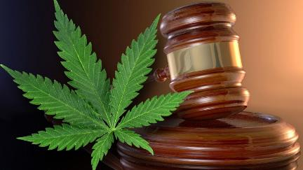
PA V. Federal Law
“Nothing in this act shall require an employer to commit any act that would put the employer or any person acting on its behalf in violation of federal law.” Section 2103(b)(3).
Notes:
“Nothing in this act shall require an employer to commit any act that would put the employer or any person acting on its behalf in violation of federal law.” Section 2103(b)(3).
Credit: PA Medical Marijuana Act 16

Slide 25

Act 16 Limitations
“Under the Influence” is determined by a blood content of more than 10 nanograms of active tetrahydrocannabis (THC) per milliliter of blood in serum.
A patient may be prohibited by an employer from performing any task which the employer deems life-threatening—to either the employee or any of the employees of the employer—while under the influence of medical marijuana.
Notes:
Act 16 Limitations:
Under the Influence” is determined by a blood content of more than 10 nanograms of active tetrahydrocannabis (THC) per milliliter of blood in serum.
A patient may be prohibited by an employer from performing any task which the employer deems life-threatening—to either the employee or any of the employees of the employer—while under the influence of medical marijuana.
PA Medical Marijuana Act 16
DrugFree WorkPlace PA

Slide 26
Act 16 Limitations
A patient may be prohibited by an employer from performing any duty which could result in a public health or safety risk while under the influence of medical marijuana.
The prohibition shall not be deemed an adverse employment decision even if the prohibition results in financial harm for the patient.
Notes:
Act 16 Limitations continued…
A patient may be prohibited by an employer from performing any duty which could result in a public health or safety risk while under the influence of medical marijuana.
The prohibition shall not be deemed an adverse employment decision even if the prohibition results in financial harm for the patient.
PA Medical Marijuana Act 16
DrugFree WorkPlace PA

Slide 27
The Workplace and Act 16
Discrimination against an employee certified to use medical marijuana is prohibited.
MMA provides that no employer “may discharge, threaten, refuse to hire or otherwise discriminate or retaliate” against an employee solely on the basis of that employee’s status as an individual who is certified to use medical marijuana.
Notes:
The Workplace and Act 16
Discrimination against an employee certified to use medical marijuana is prohibited.
MMA provides that no employer “may discharge, threaten, refuse to hire or otherwise discriminate or retaliate” against an employee solely on the basis of that employee’s status as an individual who is certified to use medical marijuana.
PA Medical Marijuana Act 16
DrugFree WorkPlace PA

Slide 28
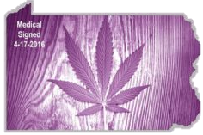
The Workplace and Act 16
MMA states that an employer is not required to accommodate the use of medical marijuana “on the property or premises of any place of employment.”
Notes:
The Workplace and Act 16
MMA states that an employer is not required to accommodate the use of medical marijuana “on the property or premises of any place of employment.”
PA Medical Marijuana Act 16
DrugFree WorkPlace PA

Slide 29
The Workplace and Act 16
Under the MMA, an employer can discipline an employee for the following reasons:
Being under the influence of medical marijuana in the workplace.
Working while under the influence of medical marijuana when the employee’s conduct and/or performance falls below the standard considered normally acceptable for their position.
In order to discipline an employee pursuant to this provision, the employee must both be under the influence of medical marijuana while at work and have their job performance fall below an acceptable level.
Notes:
Under the MMA, an employer can discipline an employee for the following reasons:
Being under the influence of medical marijuana in the workplace.
Working while under the influence of medical marijuana when the employee’s conduct and/or performance falls below the standard considered normally acceptable for their position.
In order to discipline an employee pursuant to this provision, the employee must both be under the influence of medical marijuana while at work and have their job performance fall below an acceptable level.
PA Medical Marijuana Act 16
DrugFree WorkPlace PA

Slide 30
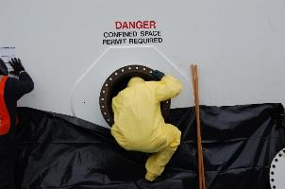
The Workplace and Act 16
If your business is subject to federal laws or regulations mandating a marijuana-free workplace, continue to abide by those requirements.
Certain safety-sensitive duties and positions are specifically addressed.
Notes:
The Workplace and Act 16
If your business is subject to federal laws or regulations mandating a marijuana-free workplace, continue to abide by those requirements.
Certain safety-sensitive duties and positions are specifically addressed.
Credit: DrugFree Workplace PA

Slide 31
The Workplace and Act 16
MMA provides that no one under the influence of medical marijuana may engage in the following job tasks: control of chemicals, which require a permit issued by federal/state government; control of high voltage electricity, any other public utility employment duties at heights or confined spaces including mining.
Under federal law, some healthcare, all transportation, and all federally regulated employees, are banned from the use of medical marijuana.
Notes:
The Workplace and Act 16
MMA provides that no one under the influence of medical marijuana may engage in the following job tasks: control of chemicals, which require a permit issued by federal/state government; control of high voltage electricity, any other public utility employment duties at heights or confined spaces including mining.
Under federal law, some healthcare, all transportation, and all federally regulated employees, are banned from the use of medical marijuana.
PA Medical Marijuana Act 16
DrugFree WorkPlace PA

Slide 32


What is a Safety Sensitive Job Position?
The following state and federal departments are examples
of Federal Safety Sensitive Industries that abide by Federal
Regulations and DO NOT recognize the use of Medical
Marijuana as a valid reason for a positive drug screen.
Department of Defense (DOD)
Nuclear Regulatory Commission (NRC)
Department of Transportation (DOT)
Individuals employed federally who work for these departments or in positions of law enforcement, national security, the protection of life and property, public health or safety—or other positions that requires a high degree of public trust—are subject to
mandatory drug testing. In turn, you can expect that most states require testing for these positions as well.
Notes:
What is a Safety Sensitive Job Position?
The following state and federal departments are examples of Federal Safety Sensitive Industries that abide by Federal
Regulations and DO NOT recognize the use of Medical Marijuana as a valid reason for a positive drug screen.
Department of Defense (DOD)
Nuclear Regulatory Commission (NRC)
Department of Transportation (DOT)
Individuals employed federally who work for these departments or in positions of law enforcement, national security, the protection of life and property, public health or safety—or other positions that requires a high degree of public trust—are subject to mandatory drug testing. In turn, you can expect that most states require testing for these positions as well.
Credit: DrugFree WorkPlace PA

Slide 33



It is Not Just Federal Jobs Assigned Safety Sensitive
Any employer—whose business is regulated by one of the industries below—is covered by the Omnibus Employee Drug Testing Act of 1991. What does this mean? It means these employers MUST follow federal guidelines for maintaining a drug free workplace policy, which does not recognize the use of Medical Marijuana as a valid reason for a positive drug test.
Federal Aviation Administration (FAA)
Federal Motor Carrier Safety Administration (FMCSA)
Federal Railroad Administration (FRA)
Federal Transit Administration (FTA)
National Highway Traffic Safety Administration (NHTSA)
Pipeline and Hazardous Materials Safety Administration (PHMSA)
United States Coast Guard
Notes:
It is Not Just Federal Jobs Assigned Safety Sensitive
Any employer—whose business is regulated by one of the industries below—is covered by the Omnibus Employee Drug Testing Act of 1991. What does this mean? It means these employers MUST follow federal guidelines for maintaining a drug free workplace policy, which does not recognize the use of Medical Marijuana as a valid reason for a positive drug test.
Federal Aviation Administration (FAA)
Federal Motor Carrier Safety Administration (FMCSA)
Federal Railroad Administration (FRA)
Federal Transit Administration (FTA)
National Highway Traffic Safety Administration (NHTSA)
Pipeline and Hazardous Materials Safety Administration (PHMSA)
United States Coast Guard
Credit: DrugFree WorkPlace PA

Slide 34


Examples of Safety Sensitive Positions
An employer whose business is not regulated by federal guidelines may still have safety sensitive positions to consider when it comes to PA Act 16 and medical marijuana. A prime example would be any employee who operates machinery.
Labeling a job as “safety sensitive” should be always be considered when the employees job performance could directly affect the safety and welfare of the employee—or ANY other employee(s).
Keep in mind when assigning safety sensitive jobs, The burden of proof falls on the employer to demonstrate that an employee’s inability or impaired ability to preform job duties would result in a direct threat to the employee or others.
To learn more about safety sensitive positions and
ensure your job descriptions are on target, visit the
official websites below.
Occupational Safety and Health Administration
https://www.osha.gov/
Substance Abuse and Mental Health Services Administration
https://www.samhsa.gov/workplace/legal/federal-laws/
safety-security-sensitive
Notes:
Examples of Safety Sensitive Positions
An employer whose business is not regulated by federal guidelines may still have safety sensitive positions to consider when it comes to PA Act 16 and medical marijuana. A prime example would be any employee who operates machinery.
Labeling a job as “safety sensitive” should be always be considered when the employees job performance could directly affect the safety and welfare of the employee—or ANY other employee(s).
Keep in mind when assigning safety sensitive jobs, The burden of proof falls on the employer to demonstrate that an employee’s inability or impaired ability to preform job duties would result in a direct threat to the employee or others.
To learn more about safety sensitive positions and ensure your job descriptions are on target, visit the official websites below.
Occupational Safety and Health Administration
https://www.osha.gov/
Substance Abuse and Mental Health Services Administration
https://www.samhsa.gov/workplace/legal/federal-laws/
safety-security-sensitive
Credit: DrugFree WorkPlace PA

Slide 35
Employers Need to Know…
Employees with a MM card should be treated like any other employee with prescription medication that could affect their ability to carry out their duties of employment.
The regular principles around duty to accommodate apply.
Accommodation does not mean allowing an employee to carry out his or her duties while impaired.
Notes:
Pennsylvania’s Medical Marijuana Act prohibits employers from discriminating against employees who use medical marijuana. Employer’s are prohibited against discharging, threatening, refusing to hire, discriminating or retaliating against employees solely based on their status as a person who is certified to use medical marijuana.
The increasing public perception that marijuana use has few risks, combined with persistent safety concerns associated with the drug, underscore the importance of a strong workplace substance abuse policy that addresses marijuana use.
Although marijuana has been legalized under some state laws, employers may still ban the drug at work.
A person using marijuana where it is legal won’t face criminal charges if the drug is used in compliance with state statutes, but its use can still have consequences in the workplace.
http://www.workplacemedical.com/medical-marijuna-workplace-safety-hazard/

Slide 36
Employers Need to Know…
An employer must carry out its health and safety due diligence at the same time it accommodates an employee.
Safety-sensitive positions, may mean reassigning an employee to a non-safety-sensitive position.
Employers can set limits if the employee says they need to smoke on the job, such as where and when they can smoke.
Notes:
PA Law does allow employers to prohibit employees from doing any of the following while under the influence of marijuana:
Operating or controlling government-regulated chemicals or high-voltage electricity
Performing duties at heights or in confined spaces including mining
Performing any tasks that threaten their own life or the lives of co-workers
Reminder: PA law does not allow smoking marijuana.
http://www.workplacemedical.com/medical-marijuna-workplace-safety-hazard/

Slide 37


Employer Proactive Actions
Re-examine workplace drug and alcohol policies. Focus on prescription and non-prescription medication segments.
Require an employee drug prescription disclosure, which may impair their safe work performance.
Prohibit employee in a safety-sensitive position from working while impaired.
Notes:
Employer Proactive Actions
Re-examine workplace drug and alcohol policies. Focus on prescription and non-prescription medication segments.
Require an employee drug prescription disclosure, which may impair their safe work performance.
Prohibit employee in a safety-sensitive position from working while impaired.
http://www.workplacemedical.com/medical-marijuna-workplace-safety-hazard/
DOT and FAA regulations should be consulted for specifics of use.
Pictures: rinj.com
blog.airgeorgian.ca

Slide 38

Employer Proactive Actions
Set a process for obtaining additional medical information to facilitate accommodation.
Those involved in the accommodation process:
- Employer
- Employee
- Union
Notes:
Employers should become proactive since more employees may become involved due to having medical marijuana recommended for certain issues. It’s a wise idea to be prepared and take the necessary steps ahead of experiencing any problems that could arise.
http://www.workplacemedical.com/medical-marijuna-workplace-safety-hazard/
Picture: alliantcreditunion.org

Slide 39

Company Drug/Alcohol Policy
Identify restrictions on use of medical marijuana in the workplace (e.g., where and when).
Identify breach of the policy actions i.e., discipline.
Employers should advise employees and candidates that such medical opinions will be required prior to the worker’s taking on safety sensitive work.
Notes:
Company drug and alcohol policies should be comprehensive and easy to understand as well as being consistently enforced for any violations of the policy that may occur.
Picture: blog.bradfordpublishing.com

Slide 40

Medical Department Actions
Obtain guidance from physicians:
How to treat medical marijuana cases
Understands the possible effects of its use versus workplace safety
Assist in guideline creation
Notes:
As it is difficult to measure individual sensitivities to the drug, a physician knowledgeable about occupational health, who also understands the potential impact of medical marijuana on workplace safety should evaluate the employee to determine if he or she can perform their job safely while taking the drug. The worker’s doctor should also sign off on this evaluation.
Picture: medicalmarijuanainc.com

Slide 41
Medical Department Actions
Occupational Health physician: acts as liaison between your organization and the employee’s family doctor to understand the condition prescribed for, the dosage, side effects, etc.
Provide expert advice and support in developing a comprehensive and effective drug and alcohol policy and when dealing with complex cases.
Set a means to obtain additional medical information to facilitate accommodation.
Notes:
Medical professionals should become an integral part of the company’s policies and procedures when addressing medical marijuana issues. Employers should establish a good working relationship with medical professionals involved.

Slide 42
Workplace Drug Testing
To promote safety
Required for safety-sensitive positions
Develop a clear drug and alcohol policy to maintaining a safe working environment and limit legal liability
Non-discrimination: employees who are registered marijuana patients can generally only be terminated for using marijuana if they use or possess marijuana while they are at work or come to work under the influence
Notes:
Employers may not discriminate against workers because they are a patient enrolled in a marijuana program or because they test positive for marijuana (if they use it medically).
You cannot terminate or refuse to hire any person who repeatedly fails drug tests. Instead, employees who are registered marijuana patients can generally only be terminated for using marijuana if they use or possess marijuana while they are at work or come to work under the influence.
This policy means that managers can no longer rely on drug tests to weed out all drug users. They must be aware of employee behavior and take action if workers are not acting safely and responsibly.
Patrick McGuiness on July 29, 2015.
http://zmattorneys.com/medical-marijuana-and-workplace-safety/
Medical marijuana and workplace safety

Slide 43
Workplace Drug Testing
Does CBD Show Up in a Workplace Drug Test?
No. Drug tests check for THC. Most CBD products only contain trace amounts of THC. It will not show up on standard drug screens companies perform, as this cannabinoid is not an indication of impairment.
At most companies, the use of CBD for medical purposes is not grounds for dismissal or workplace discipline.
Employees should thoroughly acquaint themselves with their Workplace Drug Policy.
Notes:
Does CBD Show Up in a Workplace Drug Test?
No. Drug tests check for THC. Most CBD products only contain trace amounts of THC. Will not show up on standard drug screens companies perform, as this cannabinoid is not an indication of impairment.
At most companies the use of CBD for medical purposes is not grounds for dismissal or workplace discipline.
Employees should thoroughly acquaint themselves with their Workplace Drug Policy .
https://www.marijuanadoctors.com/blog/does-cbd-show-up-in-a-drug-test/

Slide 44
Workplace Drug Testing
OSHA regulations should be reviewed since those regarding drug testing and how it can be accomplished have been recently updated.
October 11, 2018: OSHA does not prohibit post-incident drug testing. Employers who conduct post-incident drug testing do so to promote workplace safety and health. Action taken under post-incident drug testing would only violate 29 C.F.R. §1904.35(b)(1)(iv) if employer took the action to penalize the employee for reporting the injury or illness.
Notes:
OSHA regulations should be reviewed since those regarding drug testing and how it can be accomplished have been recently updated.
October 11, 2018: OSHA does not prohibit post-incident drug testing. Employers who conduct post-incident drug testing do so to promote workplace safety and health. Action taken under post-incident drug testing would only violate 29 C.F.R. §1904.35(b)(1)(iv) if employer took the action to penalize the employee for reporting the injury or illness.
OSHA Position on Position on Workplace Safety Incentive Programs and Post-Incident Drug Testing
https://www.osha.gov/laws-regs/standardinterpretations/2018-10-11

Slide 45
Workplace Drug Testing
Most instances of workplace drug testing are permissible under 29 C.F.R. §1904.35(b)(1)(iv). Examples of permissible drug testing include:
Random drug testing
Drug testing unrelated to reporting of work-related injury or illness
Drug testing under state workers’ compensation law
Drug testing under federal law, such as a U.S. Department of Transportation rule
Notes:
Most instances of workplace drug testing are permissible under 29 C.F.R. §1904.35(b)(1)(iv). Examples of permissible drug testing include:
Random drug testing
Drug testing unrelated to reporting of work-related injury or illness
Drug testing under state workers’ compensation law
Drug testing under federal law, such as a U.S. Department of Transportation rule
OSHA Position on Position on Workplace Safety Incentive Programs and Post-Incident Drug Testing
https://www.osha.gov/laws-regs/standardinterpretations/2018-10-11

Slide 46
Workplace Drug Testing
Examples of permissible drug testing include:
Drug testing to evaluate the root cause of a workplace incident that harmed or could have harmed employees. If the employer chooses to use drug testing to investigate the incident, the employer should test all employees whose conduct could have contributed to the incident, not just the employees who reported injuries.
Notes:
Examples of permissible drug testing include:
Drug testing to evaluate the root cause of a workplace incident that harmed or could have harmed employees. If the employer chooses to use drug testing to investigate the incident, the employer should test all employees whose conduct could have contributed to the incident, not just the employees who reported injuries.
OSHA Position on Position on Workplace Safety Incentive Programs and Post-Incident Drug Testing
https://www.osha.gov/laws-regs/standardinterpretations/2018-10-11

Slide 47
Workplace Drug Testing
EXCEPTIONS
Employers cannot discriminate against workers for using medical marijuana in their off hours.
Companies may bar workers from bringing marijuana to the office or worksite, and they can ban them from coming to work under the influence.
Employees with federally regulated jobs—like commercial driver or pilots—can be terminated (or never hired) for failing drug tests, even if they are legal medical marijuana users.
Another exception is that employers can still maintain a sober work environment.
Notes:
You cannot discriminate against workers for using medical marijuana in their off hours, companies may bar workers from bringing marijuana to the office or worksite, and they can ban them from coming to work under the influence.
Patrick McGuiness on July 29, 2015.
http://zmattorneys.com/medical-marijuana-and-workplace-safety/
Medical marijuana and workplace safety
Patrick McGuiness on July 29, 2015.
http://zmattorneys.com/medical-marijuana-and-workplace-safety/
Medical marijuana and workplace safety

Slide 48

Safety Concerns
Marijuana is a mind-altering drug that contains more than 400 chemicals, according to the Drug Enforcement Administration (DEA).
For those in a safety-sensitive position, the drug can pose dangers, both short-term and long-term.
Also the potency levels may not be known or have adverse effects.
Notes:
Workers also should know the rules of their state and their employer, particularly if they are subject to Department of Transportation (DOT) regulations or if their employer has federal contracts – both of which can supersede protections in state laws.
http://www.safetyandhealthmagazine.com/articles/10987-medical-marijuana-and-workplace-safety
Picture: nationaldrugscreening.com

Slide 49
Employers’ vs Workers’ Rights
If an employer can prove a worker is impaired on the job, then that employer can take action regardless of the residing state.
No impairment, but tests positive? Does the employer have the right to fire that worker as part of its drug-free workplace policy?
Colorado’s Coats v. Dish Network may provide guidance or set precedent.
In some states, judges have ruled on the side of employers.
Notes:
Coats v. Dish Network:
Plaintiff, a quadriplegic licensed to take medical marijuana.
After he failed a drug test, Dish Network fired him from his job as a customer service representative.
Plaintiff sued the company, but the state’s Court of Appeals sided with Dish Network.
At press time, the case was pending in the Colorado Supreme Court.
In June 2015, the Colorado Supreme Court ruled against Mr. Coats.
http://www.safetyandhealthmagazine.com/articles/10987-medical-marijuana-and-workplace-safety

Slide 50
Predictors of What is to Come
In 2015, the Colorado Supreme Court decided that the termination of an employee using medical marijuana was justified because marijuana is still illegal under federal law.
In states that have made medical marijuana legal, employees are finding protection under the state disability laws. The courts were initially in favor of the employer; however, the courts are quickly shifting decisions in favor of the employee.
Notes:
Predictors of What is to Come:
In 2015, the Colorado Supreme Court decided that the termination of an employee using medical marijuana was justified because marijuana is still illegal under federal law.
In states that have made medical marijuana legal, employees are finding protection under the state disability laws. The courts were initially in favor of the employer; however, the courts are quickly shifting decisions in favor of the employee.
Credit: DrugFree WorkPlace PA

Slide 51
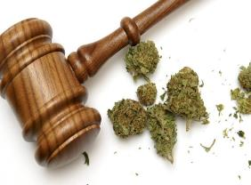
Predictors of What is to Come
In May of 2017, in Rhode Island, a job candidate was not hired because she disclosed to her potential employer that she was a legal MM cardholder. She informed the employer that she would not pass a pre-employment drug screen. When she was not hired, she sued the employer for discrimination. The court found in favor of the potential employee.
Notes:
Predictors of What is to Come:
In May of 2017, in Rhode Island, a job candidate was not hired because she disclosed to her potential employer that she was a legal MM cardholder. She informed the employer that she would not pass a pre-employment drug screen. When she was not hired, she sued the employer for discrimination. The court found in favor of the potential employee.
Credit: DrugFree WorkPlace PA

Slide 52
Predictors of What is to Come
In July of 2017, the Massachusetts High Court heard the case of an employee who sued her employer for discrimination under the states discrimination laws. She had been fired for failing a drug test while being legally registered as a medical marijuana user.
In turn, the employer argued that this was an unreasonable accommodation request as all marijuana use is illegal under federal law and is, therefore, a federal crime. The court disagreed with the employer and sided with the employee.
The court held that under the state’s disability discrimination law, employees have the right to seek a reasonable accommodation for MM use. The employer did not appeal the decision.
Notes:
Predictors of What is to Come:
In July of 2017, the Massachusetts High Court heard the case of an employee who sued her employer for discrimination under the states discrimination laws. She had been fired for failing a drug test while being legally registered as a medical marijuana user.
In turn, the employer argued that this was an unreasonable accommodation request as all marijuana use is illegal under federal law and is, therefore, a federal crime. The court disagreed with the employer and sided with the employee.
The court held that under the state’s disability discrimination law, employees have the right to seek a reasonable accommodation for MM use. The employer did not appeal the decision.
Credit: DrugFree WorkPlace PA

Slide 53

Predictors of What is to Come
In August 2017, in Connecticut, a similar situation was heard. The employer appealed the decision of state court to federal court. The Federal District Court rejected the employers Federal Pre-Emption Argument.
The court said the Federal Controlled Substance Act does not regulate employment and therefore does not make it illegal to employ a medical marijuana user.
Notes:
Predictors of What is to Come:
In August 2017, in Connecticut, a similar situation was heard. The employer appealed the decision of state court to federal court. The Federal District Court rejected the employers Federal Pre-Emption Argument.
The court said the Federal Controlled Substance Act does not regulate employment and therefore does not make it illegal to employ a medical marijuana user.
Credit: DrugFree WorkPlace PA

Slide 54




Federal DOT Stance
Federal DOT Stance
We want to make it perfectly clear that the Department of Justice guidelines will have no bearing on the Department of Transportation's regulated drug testing program. We will not change our regulated drug testing program based upon these guidelines to federal prosecutors…
Notes:
Federal DOT Stance:
The Department of Transportation’s Drug and Alcohol Testing Regulation – 49 CFR Part 40, at 40.151(e) – does not authorize “medical marijuana” under a state law to be a valid medical explanation for a transportation employee’s positive drug test result.
Medical Review Officers will not verify a drug test as negative based upon information that a physician recommended that the employee use “medical marijuana.” Please note that marijuana remains a drug listed in Schedule I of the Controlled Substances Act. It remains unacceptable for any safety‐sensitive employee subject to drug testing under the Department of Transportation’s drug testing regulations to use marijuana.
Credit: DrugFree WorkPlace PA

Slide 55
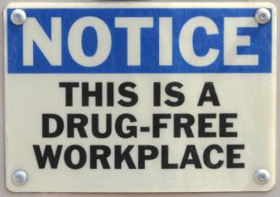
Employers’ vs Workers’ Rights
“State laws vary, but employers still have the right to enforce drug-free workplace policies and dismiss workers if they can prove impairment on the job, experts say.”
Julie Carter, Director of Environmental, Health and Safety, Roy Anderson Corp, Gulfport, MS
Notes:
This statement by Julie Carter, Director of Environmental, Health and Safety, Roy Anderson Corp, Gulfport, MS presents the concept that an employer can still enforce drug-free workplace policies which can also include terminating employees who are impaired on the job.
Picture: blog.employeersolutions.com

Slide 56
Effects on Job Safety
“Marijuana is 10 to 20 times stronger today than in the 1960’s and 1970’s.”
“The THC component affects depth perception, reaction time, coordination and other motor skills and creates sensory distortion.”
“Those who tested positive had 55% more industrial accidents, 85% more injuries and 75% more absenteeism compared to those who tested negative.”
“It’s an addictive drug.”
“Car crashes involving marijuana increased 300% between 2010 and 2013 and continue to rise.”
Christine Clearwater, president of Drug-free Solutions Group in a webinar for the National Safety Council
Notes:
Christine Clearwater, president of Drug-free Solutions Group in a webinar for the National Safety Council presented the information listed to employers as a matter of information for consideration.

Slide 57

Use Results
Productivity – decreased
Workers comp and unemployment comp claims-increased
High turnover
Lawsuits
“Expect to pay $7,000 a year on an employee who uses drugs. About one in six has a substance abuse problem. Example: A company with 500 employees the expenditure would be about $600,000 a year.”
Christine Clearwater, president of Drug-free Solutions Group in a webinar for the National Safety Council
Notes:
The additional information was also provided during the presentation by Christine Clearwater, president of Drug-free Solutions Group in a webinar for the National Safety Council as “food for thought.”

Slide 58
Legal Facts
ADA sides with employer regarding medical marijuana.
Most states will not pay workers comp to an employee under the influence at the time of an incident.
Most state health insurance programs will not pay for medical marijuana.
Christine Clearwater, president of Drug-free Solutions Group in a webinar for the National Safety Council
Notes:
Christine Clearwater, president of Drug-free Solutions Group in a webinar for the National Safety Council presented even more information on medical marijuana.

Slide 59
Employer Policy
Management training to make managers more likely to enforce the policy
Access to support for employees with drug problems (formal assistance or referral to local resources)
Clearly define use and possession meanings for employees
Establish rules for post-accident testing
Indicate how you will handle an employee’s conviction or arrest
Notes:
Information listed was presented by Christine Clearwater, president of Drug-free Solutions Group in a webinar for the National Safety Council.

Slide 60
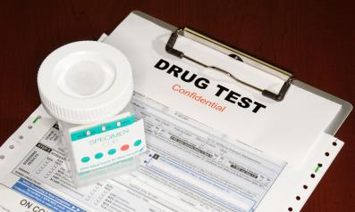
Drug Policy
Supported by workplace procedures.
Very specific to reduce chances of litigation.
Ensure compliance with federal and state laws as well as other regulations which pertain, i.e. DOT and federal contract requirements.
Reviewed by the company’s legal counsel.
Notes:
Additional information presented by Christine Clearwater, president of Drug-free Solutions Group in a webinar for the National Safety Council.
Picture: associationsnow.com

Slide 61
Summary
Medical marijuana has the potential to relieve pain for a variety of serious medical conditions.
The use at the workplace has potential for safety issues.
Create workplace policies addressing the parameters for use.
Support by workplace procedures.
Ensure compliance with federal and state laws as well as other regulations which pertain, i.e. DOT and federal contract requirements.
Have your legal representation review all program aspects.
Notes:
Summary:
Medical marijuana has the potential to relieve pain for a variety of serious medical conditions.
The use at the workplace has potential for safety issues.
Create workplace policies addressing the parameters for use.
Support by workplace procedures.
Ensure compliance with federal and state laws as well as other regulations which pertain, i.e. DOT and federal contract requirements.
Have your legal representation review all program aspects.

Slide 62
Summary
Employers need to stay aware of recent court decisions and legislative developments as they create and implement their workplace drug use policies.
Employers should appreciate the limitations of marijuana testing and how those limitations affect their practices and policies.
In the meantime, judges are siding with employees who use medical marijuana, outside of work, in conformance with local law.
Notes:
In light of the wave of legislative and judicial developments across the nation, employers need to stay aware of recent court decisions and legislative developments as they create and implement their workplace drug use policies. Also, employers should appreciate the limitations of marijuana testing and how those limitations affect their practices and policies. In the meantime, judges are siding with employees who use medical marijuana, outside of work, in conformance with local law.

Slide 63

Contact Information
Health & Safety Training Specialists
(717) 772-1635
RA-LI-BWC-PATHS@pa.gov
PPT-162-05
63
Notes:
We invite you to contact us concerning other free training materials and opportunities.

Slide 64
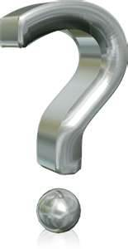
Questions
PPT-162-05
64

Slide 65
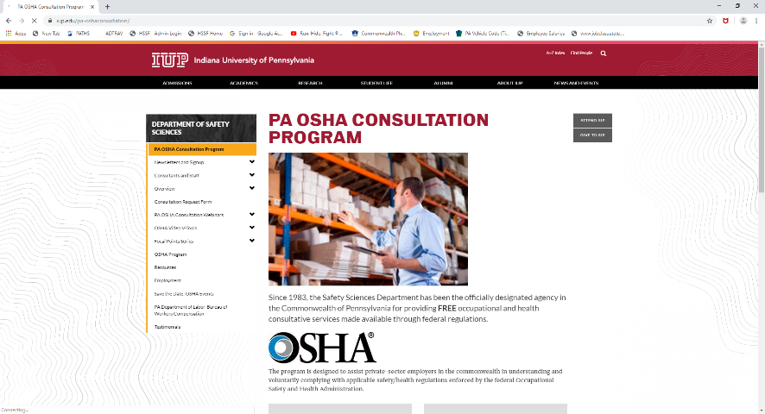
IUP OSHA Consultation Program
Telephone Number 1-800-382-1241
Notes:
Since 1983, the Safety Sciences Department of Indiana University of Pennsylvania has been the officially designated agency in the Commonwealth of Pennsylvania for providing FREE occupational and health consultative services made available through federal regulations.
The program is designed to assist private-sector employers in the commonwealth in understanding and voluntarily complying with applicable safety/health regulations enforced by the federal Occupational Safety and Health Administration.
This program was designed to assist small business employers with 500 or less employees, however program representatives are able to answer OSHA related questions.

Slide 66

PennOSHS Program

Slide 67
Bibliography
http://www.mayoclinic.org/healthy-lifestyle/consumer-health/in-depth/medical-marijuana/art-20137855?pg=2
FINAL%20Medical%20Marijuana%20FAQs%20053116.pdf
http://www.mayoclinic.org/drugs-supplements/marijuana/safety/HRB-20059701
http://www.cancer.org/treatment/treatmentsandsideeffects/physicalsideeffects/chemotherapyeffects/marijuana-and-cancer

Slide 68
Bibliography
Patrick McGuiness, Medical marijuana and workplace safety, July 29, 2015.
http://zmattorneys.com/medical-marijuana-and-workplace-safety/
http://www.safetyandhealthmagazine.com/articles/10987-medical-marijuana-and-workplace-safety

Slide 69
Bibliography
Christine Clearwater, president of Drug-free Solutions Group in a webinar for the National Safety Council
Julie Carter, Director of Environmental, Health and Safety, Roy Anderson Corp, Gulfport, MS in an NSC webinar
“High hopes for cannabis,” Stacy Gault, The American Legion Magazine, November, 2016.
Journal of Occupational Environmental Medicine, “Medical Marijuana in the Workplace”

Slide 70
Bibliography
How to get Medical Marijuana:
https://www.pa.gov/guides/pennsylvania-medical-marijuana-program/#HowtoGetMedicalMarijuana
Clarification of OSHA’s Position on Workplace Safety Incentive Programs and Post-Incident Drug Testing
https://www.osha.gov/laws-regs/standardinterpretations/2018-10-11

Slide 71

Bibliography
https://www.naturalnews.com/034425_marijuana_cannabinoids_medicine.html
PA Bulletin: May 12, 2018
DrugFree WorkPlace PA website
CDC website
www.drugrehab.com

Slide 72
Bibliography
http://www.chronictherapy.co/hemp-oil-vs-cbd-oil-whats-the-difference-2/
https://redstormscientific.com/side-effects-of-cbd-and-hemp-oil/
https://www.marijuanadoctors.com/resources/cbd-vs-thc/

Slide 73
Bibliography
https://www.marijuanadoctors.com/blog/does-cbd-show-up-in-a-drug-test/
https://news.unm.edu/news/notorious-psychoactive-chemical-thc-more-important-for-therapeutic-effects-in-cannabis-than-previously-believed
Cohen Seglias Pallas Greenhall & Furman, P.C.

Slide 74
Other Suggested Programs
The following presentations are also available to supplement your in-house program:
Drug & Alcohol Awareness-Employee
Drug & Alcohol Awareness-Supervisors
Opioid Addiction
Please contact us for a full list of other programs available to you free of charge.

