Slide 1
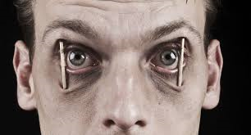
Sleep vs. Fatigue
Bureau of Workers’ Compensation
PA Training for Health & Safety (PATHS)
LACK OF SLEEP AND FATIQUE, ARE THEY THE SAME THING?

Slide 2
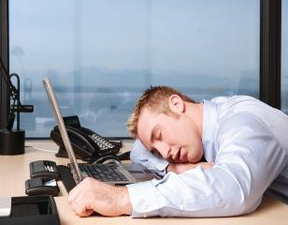
Topics
Definitions/Causes of Sleepiness and Fatigue
About sleep
- Patterns and Stages
- How much sleep do we need?
Sleep Disorders
- Types
- Prevalence
- Symptoms
- Causes
Sleep deprivation and the consequences
Notes:
Definitions/Causes of Sleepiness and Fatigue
About sleep
Patterns and Stages
How much sleep do we need?
Sleep Disorders
Types
Prevalence
Symptoms
Causes
Sleep deprivation and the consequences

Slide 3
Definition of Sleepiness
Sleepiness is the desire to fall asleep.
It is sometimes referred to as drowsiness and typically increases the longer we stay awake.
Notes:
Sleepiness is the desire to fall asleep. It is sometimes referred to as drowsiness and typically increases the longer we stay awake.

Slide 4
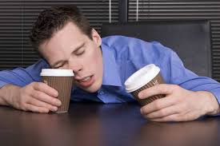
Causes of Sleepiness
Not getting enough sleep, sometimes by choice, is the most common cause of excessive sleepiness.
Working at night and sleeping during the day.
Other causes include drug, alcohol, or cigarette use, lack of physical activity, obesity, and the use of certain medications.
Notes:
Not getting enough sleep -- sometimes by choice -- is the most common cause of excessive sleepiness. Working at night and sleeping during the day is another. Other causes include drug, alcohol, or cigarette use, lack of physical activity, obesity, and the use of certain medications.

Slide 5
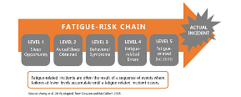
Definition of Fatigue
Fatigue is generally defined as a feeling of lack of energy and motivation that can be physical, mental or both. Fatigue is not the same as drowsiness, but the desire to sleep may accompany fatigue.
Apathy is a feeling of indifference that may accompany fatigue or exist independently. In addition, individuals often describe fatigue using a variety of terms including weary, tired, exhausted, malaise, listless, lack of energy and feeling run down.
Notes:
Lack of energy and motivation that can be physical, mental or both. Fatigue is not the same as drowsiness, but the desire to sleep may accompany fatigue.

Slide 6
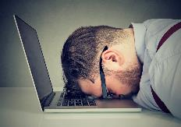
Causes of Fatigue
Causes of fatigue range from those that cause poor blood supply to the body's tissues to illnesses that affect metabolism, from infections and inflammatory diseases to those that cause sleep disturbances.
Fatigue is a common side effect of many medications. While numerous patients with psychological conditions often complain of fatigue (physical and mental), there are also a group of patients where the cause of fatigue is never diagnosed.
Notes:
There are numerous potential causes of fatigue. Causes can be anything from poor blood supply to the body's tissues to illnesses that affect metabolism, infections and inflammatory diseases to those that cause sleep disturbances. Fatigue is also a common side effect of many medications.

Slide 7
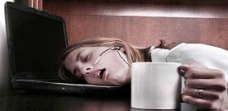
Sleepiness vs. Fatigue
Sleepiness and fatigue are two distinct conditions.
Sleepiness refers to the inability to stay awake even in situations in which wakefulness is required, such as at work or behind the wheel of a car.
Fatigue is a state of overwhelming sustained exhaustion and decreased capacity for physical and mental work that is not relieved by rest.
Notes:
Many believe that being sleepy and being fatigued are the same thing, they are not. If you’re sleepy, getting rest will cure that. If you are fatigued, rest does not cure the effects of feeling run down both physically and mentally.

Slide 8
Sleep vs. Fatigue
We spend 1/3 of our lives asleep
Sleep is an active process
No organ or regulatory system “shuts down”
Slight decrease in metabolic rate
Some brain activity increases during sleep
Delta Waves
Many parts of the brain are as active as awake periods
Specific hormones increase during sleep
Melatonin
Growth
Notes:
Sleepiness and drowsiness can often be solved by getting regular and consistent sleep. Fatigue, especially chronic fatigue, is usually linked to a medical condition or health problem. Fatigue connotes a longer time period than sleepiness. While sleepiness can generally go away after a few hours of sleep, fatigue may take longer to recover from. There is even “chronic fatigue syndrome”. Some distinguish between muscle or physical fatigue and mental fatigue. The dividing line here is unclear because our mental lives derive from physical processes.

Slide 9
Sleep vs. Fatigue
5 stages of sleep during a normal night
Stages 1-4 or non-REM and REM (rapid eye movement)
During non-REM sleep (NREM), many of the restorative functions of sleep occur
During REM sleep, memories and thoughts from the day are processed
Notes:
Usually sleepers pass through four stages: 1, 2, 3, and REM (rapid eye movement) sleep. These stages progress cyclically from 1 through REM then begin again with stage 1. A complete sleep cycle takes an average of 90 to 110 minutes, with each stage lasting between 5 to 15 minutes. The first sleep cycles each night have relatively short REM sleeps and long periods of deep sleep but later in the night, REM periods lengthen and deep sleep time decreases.

Slide 10
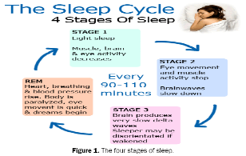
Stages of Sleep
Stages progress cyclically
1-4 , then REM, restart back at stage 1
One complete cycle takes about 90-110 minutes
First cycles have relatively short REM sleeps
REM sleep time increases in later cycles
Notes:
Usually sleepers pass through four stages: 1, 2, 3, and REM (rapid eye movement) sleep. These stages progress cyclically from 1 through REM then begin again with stage 1. A complete sleep cycle takes an average of 90 to 110 minutes, with each stage lasting between 5 to 15 minutes. The first sleep cycles each night have relatively short REM sleeps and long periods of deep sleep but later in the night, REM periods lengthen and deep sleep time decreases.

Slide 11
Stages
Stage 1
- Light sleep, drift in and out, awaken easily
- Eyes move slowly, muscle activity slows
- May experience a sense of falling followed by sudden muscle contractions
Stage 2
- Eye movement stops
- Brain waves are slower, occasional bursts of rapid waves
Notes:
Stage 1 is the lightest stage of NREM sleep. Often defined by the presence of slow eye movements, this drowsy sleep stage can be easily disrupted causing awakenings or arousals. Muscle tone throughout the body relaxes and brain wave activity begins to slow from that of wake. Occasionally people may experience hypnic jerks or abrupt muscle spasms and may even experience sensation of falling while drifting in and out of Stage 1.
Stage 2 is the first actual stage of defined NREM sleep. Awakenings or arousals do not occur as easily as in Stage 1 sleep and the slow moving eye rolls discontinue. Brain waves continue to slow with specific bursts of rapid activity known as sleep spindles intermixed with sleep structures known as K complexes. Both sleep spindles and K complexes are thought to serve as protection for the brain from awakening from sleep. Body temperature begins to decrease and heart rate begins to slow.

Slide 12
Stages
Stage 3
- Extremely slow waves-Delta waves
- Interspersed with smaller faster waves
- Considered deep sleep
- No eye or muscle movement, difficult to awaken
- Time when sleepwalking, bedwetting, or terrors occur
Stage 4
- Almost exclusively Delta waves
- Considered deep sleep
Notes:
Stage 3 is known as deep NREM sleep. The most restorative stage of sleep, stage 3 consists of delta waves or slow waves. Awakenings or arousals are rare and often it is difficult to awaken someone in Stage 3 sleep. Some studies believe that there is a fourth stage of sleep, commonly referred to as deep sleep.

Slide 13
Rapid Eye Movement Stage
Brain waves increase to the awake level
Most dreams occur during this stage
- If awoken in this stage, most people remember their dreams
Physical changes during REM
- Increase in H.R., B.P., and breathing rate
- Breathing shallower and irregular
- Eyes jerk rapidly
- Limb muscles temporarily paralyzed
- Some loss of temperature regulation
Notes:
A person’s sleep time (approximately 6-8 hours for adults) can be thought of as 2 halves. The first half for a majority of people consists mostly of Stages 2 and 3 with sporadic periods of Stage 1 and short REM periods. As the night progresses, Stage 3 begins to diminish in quantity while Stages 1 and 2 remain with lengthening periods of REM occurring.
A person typically experiences three to five REM periods throughout sleep time with the longest REM period right before awakening for the day. If woken prematurely from completing the REM period a person can experience a period of sleep inertia whereby a heightened sensation of sleepiness can occur for several minutes or even several hours.
In the REM period, breathing becomes more rapid, irregular and shallow, eyes jerk rapidly, and limb muscles are temporarily paralyzed. Brain waves during this stage increase to levels experienced when a person is awake. Also, heart rate increases, blood pressure rises, males develop erections, and the body loses some of the ability to regulate its temperature.

Slide 14
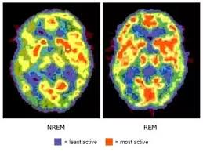
Rapid Eye Movement Stage
Most people have 3-5 intervals of REM each night
Infants spend 50% of time in REM
Adults spend nearly half of time in Stage 2
- 20% in REM, other 30% divided among other stages
- Progressively spend less time in REM as we age
14
Notes:
REM sleep, also known as rapid eye movement, is most commonly known as the dreaming stage. Eye movements are rapid, moving from side to side and brain waves are more active than in Stages 2 & 3 of sleep. Awakenings and arousals can occur more easily in REM; being woken during a REM period can leave one feeling groggy or overly sleepy.

Slide 15
Sleep vs. Fatigue
Infants 16-20
Toddlers 12-14
Pre School 11-13
School Age 10-11
Teens 9.5-10
Most adults need 7½-8 hours of sleep to function well
- About 10% require more sleep (or less)
- Pregnant women need more sleep
Notes:
Sleep changes throughout a person’s life. From a newborn, through toddler years, school age, adolescent and adulthood, sleep is changing.
Newborn (0 – approximately 4 months) Do not have distinctive sleep waves. Sleep is categorized as “Active”, “Quiet” and “Indeterminate”. Active sleep is the equivalent to REM sleep and quiet sleep is equivalent to non-REM sleep. A majority of the time, newborns are in active sleep which allows for frequent arousals or awakenings; this is necessary for regular periods of feeding.
Infants (Approximately 4 months – 1 year) Standard sleep stage distinction is now apparent. Sleep becomes more consolidated and sleeping routines can be developed, sleep is typically 10-13 hours per 24 hour period with 2-3 daytime naps occurring.
Toddlers (1 year – 3 years) With sleeping patterns fully developed, children spend approximately 25% in Stage 3 deep sleep with almost an equal amount of time in REM. Average sleep time is 9.5-10.5 hours per 24 hour period. Typically naps will reduce to 1 per day most likely occurring early in the afternoon to allow for proper nighttime sleep.
Pre-School (3 – 6 years) Sleep time is similar to that of toddlers, approximately 9-10 hours per 24 hour period. The afternoon nap usually subsides around 3-4 years for a majority of children. Stage 3 sleep still remains high in relation to total sleep time.
School Age (6 years – 12 years) Sleep time remains unchanged; 9-10 hours per 24 hour period and Stage 3 remains approximately 20-25% of total sleep time. Restorative sleep is important for growth and development.
Adolescent (12 years and beyond) Sleep time for adolescents is approximately 9-9.5 hours per 24 hour period. There are physiological changes in circadian rhythm that occur causing sleep onset to be later. This internal shift is the cause for many adolescents to have later lights out and the desire to want to “sleep in” in the morning. As a person ages, the circadian rhythm shifts back and sleep again appears to regulate to approximately 6.5-8 hours of sleep per 24 hour period as adult.

Slide 16
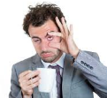
Sleep vs. Fatigue
An estimated 50% of Americans are sleep deprived
30% average less than 6 hours per night
Estimated 70 million with insufficient sleep
7 out of 10 have trouble sleeping
40 million suffer from some long-term disorder
20 million experience occasional problems
1/3 of Americans have symptoms of insomnia
Notes:
Forty-five percent of Americans say that poor or insufficient sleep affected their daily activities at least once in the past seven days, according to the National Sleep Foundation’s inaugural Sleep Health Index™. The Sleep Health Index™ is a new annual general population poll that tracks Americans’ sleep behaviors and trends. The Index uncovers valuable insights into Americans’ sleep beliefs, habits, knowledge and disorders and demonstrates areas for sleep health improvement.
Americans report sleeping an average of 7 hours and 36 minutes a night; on average going to bed at 10:55 p.m. and waking at 6:38 a.m. on workdays, and sleeping roughly 40 minutes longer on non-workdays or weekends. Despite sleeping within the recommended number of hours a night, 35 percent of Americans report their sleep quality as “poor” or “only fair.”

Slide 17
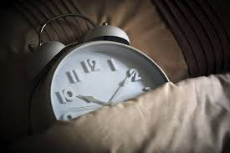
Sleep vs. Fatigue
Why Don’t People Get Enough Sleep?
● Not going to bed! Inadequate time in bed…
- Must be “productive” mentality
- Attitude that sleeping is not necessary
● Poor Sleep Hygiene
● Sleep Disorders
Notes:
Many people do not realize how important sleep is. Instead, they may think of it as a waste of time. But time spent in bed asleep is time well spent. There are many very important things that the brain needs to do while asleep. These include forming memories and going through the day’s events. Give it a chance to do these things, make sure that you spend enough time in bed.

Slide 18
Common Sleep Disorders
Snoring/Apnea
Insomnia 9-12%
Narcolepsy
Restless leg syndrome-5%
Over 80 different disorders
Disorders Website, University of MD
http://www.umm.edu/sleep/adult_sleep_dis.htm
Notes:
Sleep disorders such as insomnia, sleep apnea and restless legs can be very bad for your sleep. They may not be recognized for years.
There are many other things that can disturb sleep. It could be a medical condition such as asthma or painful arthritis. Or it could be something psychological. The key here is find the causes and deal with them. Pregnancy can disturb for your sleep, especially in the final months. Leg cramps, discomfort in the chest and having to go to the bathroom all play a part in this.

Slide 19
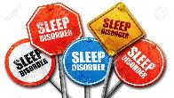
Signs of Sleep Disorders
Consistent failure to get enough sleep or restful sleep
Consistently feeling tired upon waking &/or waking with a headache
Chronic fatigue, tiredness, sleepiness during the day
Struggling to stay awake while driving or doing something passive, e.g., watching TV
Notes:
The public health consequences of sleep loss and sleep-related disorders are far from benign. The most visible consequences are errors in judgment contributing to disastrous events such as the space shuttle Challenger (Walsh et al., 2005). Less visible consequences of sleep conditions are far more prevalent, and they take a toll on nearly every key indicator of public health: mortality, morbidity, performance, accidents and injuries, functioning and quality of life, family well-being, and health care utilization. Some of these consequences, such as automobile crashes, occur acutely within hours (or minutes) of the sleep disorder, and thus are relatively easy to link to sleep problems. Others—for example, obesity and hypertension—develop more insidiously over months and years of chronic sleep problems. After decades of research, the case can be confidently made that sleep loss and sleep disorders have profound and widespread effects on human health.

Slide 20
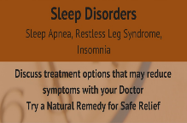
Signs of Sleep Disorders
Difficulty concentrating at work or school
Slowed or unusually delayed response to stimuli or events
Difficulty remembering things or controlling emotions
Frequent urge to nap during the day
Snoring or ceasing to breathe during sleep
Notes:
Although there are around 90 distinct sleep disorders, according to the International Classification of Sleep Disorders (AASM, 2005), most are marked by one of these symptoms: excessive daytime sleepiness, difficulty initiating or maintaining sleep, or abnormal movements, behaviors, and sensations occurring during sleep. The cumulative effects of sleep loss and sleep disorders have been associated with a wide range of deadly health consequences including an increased risk of hypertension, diabetes, obesity, depression, heart attack, and stroke.

Slide 21
Primary Insomnia
Difficulty initiating sleep, maintaining sleep, and/ or nonrestorative sleep for at least 1 month
Primary: insomnia is not related to other medical or psychiatric problems
One of the most common sleep disorders: 1/3 of general population
Women report insomnia 2x as often as men
Notes:
Primary insomnia is a term that has been used to apply to insomnia not due to another medical or psychiatric disorder, as compared to insomnia that is secondary to other disorders.

Slide 22
Primary Insomnia
Contributing Factors:
Medical factors, such as pain & physical discomfort and respiratory problems
High body temperature
Inactivity during the day
Psychological disorders
Stress
Unrealistic expectations regarding sleep
Poor bedtime habits or sleep hygiene
Rebound insomnia (sleeping pills)
Notes:
Insomnia can be caused by psychiatric and medical conditions, unhealthy sleep habits, specific substances, and/or certain biological factors. Recently, researchers have begun to think about insomnia as a problem of your brain being unable to stop being awake (your brain has a sleep cycle and a wake cycle—when one is turned on the other is turned off—insomnia can be a problem with either part of this cycle: too much wake drive or too little sleep drive). It's important to first understand what could be causing your sleep difficulties.
Medical Causes of Insomnia
There are many medical conditions (some mild and others more serious) that can lead to insomnia. In some cases, a medical condition itself causes insomnia, while in other cases, symptoms of the condition cause discomfort that can make it difficult for a person to sleep.
Medications such as those taken for the common cold and nasal allergies, high blood pressure, heart disease, thyroid disease, birth control, asthma, and depression can also cause insomnia.
If you have trouble sleeping on a regular basis, it's a good idea to review your health and think about whether any underlying medical issues or sleep disorders could be contributing to your sleep problems. In some cases, there are simple steps that can be taken to improve sleep (such as avoiding bright lighting while winding down and trying to limit possible distractions, such as a TV, computer, or pets). While in other cases, it's important to talk to your doctor to figure out a course of action. You should not simply accept poor sleep as a way of life-talk to your doctor or a sleep specialist for help.
Insomnia can be caused by psychiatric conditions such as depression. Psychological struggles can make it hard to sleep, insomnia itself can bring on changes in mood, and shifts in hormones and physiology can lead to both psychiatric issues and insomnia at the same time.
Most adults have had some trouble sleeping because they feel worried or nervous, but for some it's a pattern that interferes with sleep on a regular basis. Anxiety symptoms that can lead to insomnia include:
•Tension
•Getting caught up in thoughts about past events
•Excessive worrying about future events
•Feeling overwhelmed by responsibilities
•A general feeling of being revved up or overstimulated
It's not hard to see why these symptoms of general anxiety can make it difficult to sleep. Anxiety may be associated with onset insomnia (trouble falling asleep), or maintenance insomnia (waking up during the night and not being able to return to sleep). In either case, the quiet and inactivity of night often brings on stressful thoughts or even fears that keep a person awake.
When this happens for many nights (or many months), you might start to feel anxiousness, dread, or panic at just the prospect of not sleeping. This is how anxiety and insomnia can feed each other and become a cycle that should be interrupted through treatment. There are cognitive and mind-body techniques that help people with anxiety settle into sleep, and overall healthy sleep practices that can improve sleep for many people with anxiety and insomnia.
Insomnia can be triggered or perpetuated by your behaviors and sleep patterns. Unhealthy lifestyles and sleep habits can create insomnia on their own (without any underlying psychiatric or medical problem), or they can make insomnia caused by another problem worse.
Some cases of insomnia start out with an acute episode but turn into a longer-term problem. For example, let's say a person can't sleep for a night or two after receiving bad news. In this case, if the person starts to adopt unhealthy sleep habits such as getting up in the middle of the night to work, or drinking alcohol before bed to compensate, the insomnia can continue and potentially turn into a more serious problem. Instead of passing, it can become chronic.
Once this happens, worry and thoughts such as, "I'll never sleep," become associated with bedtime, and every time the person can't sleep, it reinforces the pattern.
This is why it's important to address insomnia instead of letting it become the norm. If lifestyle and unhealthy sleep habits are the cause of insomnia, there are cognitive behavioral techniques and sleep hygiene tips that can help. If you have tried to change your sleep behaviors and it hasn't worked, it's important to take this seriously and talk to your doctor.

Slide 23
Primary Insomnia
Treatments:
Prescription drugs
Relaxation training
Stimulus control procedures
Setting regular bedtime routines
Sleep restriction
Confronting unrealistic expectations about sleep
Notes:
Cognitive Behavior Therapies for Insomnia
Charles M. Morin, ... Simon Beaulieu-Bonneau, in Principles and Practice of Sleep Medicine (Sixth Edition), 2017
Clinical and Practical Considerations
CBT approaches to treating primary insomnia are time limited, structured, and sleep focused. For typical patients with chronic insomnia, direct consultation time takes between 4 and 6 hours per patient, which is usually spread over a treatment period of 6 to 8 weeks. The amount of direct clinical contact and the number of follow-up visits are likely to vary as a function of several factors, including insomnia severity, comorbidity, use of hypnotic medications, and the patient's motivation and education. This treatment period is considerably shorter than for other forms of psychotherapy, and it is shorter than behavioral approaches applied to other health and psychological problems (e.g., chronic pain, anxiety, depression).
Despite ample evidence supporting the efficacy of CBT for insomnia, there is a shortage of data on the effect of adherence on outcomes. Although there is a need for adding standardized measures of treatment adherence in clinical studies,112 the success of CBT depends largely on the patient's compliance with the recommended changes. For this reason, it is particularly important to schedule follow-up visits after the initial evaluation to address adherence. Although treatment is generally well accepted by patients, it is more time-consuming and requires more effort than drug therapy for both clinicians and patients. Thus it is crucial to find ways to optimize adherence by using motivational interviewing strategies, soliciting the bed partner's collaboration, and providing feedback and guidance early in treatment.113 Given the multifactorial nature of insomnia, it is often necessary to combine several clinical procedures rather than to rely on a single treatment modality. Sleep restriction is almost always relevant for an insomnia patient, and the use of this procedure early in therapy is likely to produce rapid therapeutic benefits. Some stimulus control procedures (e.g., getting out of bed when unable to sleep) might not be necessary early on when the initial sleep window is restricted to 5 to 6 hours per night, but those procedures become particularly relevant as the sleep window is increased. Relaxation is helpful for persons with elevated tension or anxiety; however, caution is needed because some patients have a paradoxical response and become more anxious. Cognitive therapy is particularly helpful to challenge some misconceptions about sleep and daytime impairments, to alleviate emotional distress, and to minimize recurrence of sleep disturbances over time. For milder forms of insomnia, basic sleep hygiene education may be sufficient, whereas more severe insomnia often requires multimodal interventions and more frequent follow-up visits.

Slide 24
Narcolepsy
Features:
- Daytime sleepiness
- Irresistible attacks of sleep occur almost daily
- Cataplexy – sudden loss of muscle power (associated with intense emotion & the sudden onset of REM sleep)
Treatments:
- Stimulants
- Antidepressants
Notes:
Narcolepsy is a neurological disorder that affects the control of sleep and wakefulness. People with narcolepsy experience excessive daytime sleepiness and intermittent, uncontrollable episodes of falling asleep during the daytime. These sudden sleep attacks may occur during any type of activity at any time of the day.
There is no cure for narcolepsy, but medications and lifestyle modifications can help you manage the symptoms. Certain over-the-counter drugs, such as allergy and cold medications, can cause drowsiness. If you have narcolepsy, your doctor will likely recommend that you avoid taking these medications.
Emerging treatments being investigated for narcolepsy include drugs acting on the histamine chemical system, hypocretin replacement, hypocretin gene therapy and immunotherapy, but further research is needed before any may be available in your doctor.

Slide 25
Breathing Disorders
Sleep is disrupted by a sleep-related breathing condition
Breathing is interrupted during sleep, producing numerous brief arousals during the night
Leads to excessive sleepiness during the day
Treatments:
Weight loss
Medications to stimulate breathing
Mechanical devices to reposition tongue or jaw
Notes:
The term breathing-related sleep disorder refers to a spectrum of breathing anomalies ranging from chronic or habitual snoring to upper airway resistance syndrome (UARS) to obstructive sleep apnea (OSA) or, in some cases, obesity hypoventilation syndrome (OHS).

Slide 26
Sleep Apnea
Symptoms: restricted airflow &/or brief periods (10-30 seconds) whereby breathing ceases completely
Signs: loud snoring, heavy sweating during the night, morning headaches, sleep attacks during the day
Obstructive Sleep Apnea: airflow stops despite continued respiratory activity; airway is too narrow, damaged, abnormal
Notes:
•Obstructive sleep apnea syndrome (OSAS) is a major public health problem.
•Obesity is a major risk factor for OSAS but a significant minority of affected individuals are not obese.
•The main treatment for OSAS is continuous positive airway pressure – a highly effective and economical intervention.
•Untreated OSAS greatly increases the risk of accidents due to sleepiness.
•Obesity hypoventilation syndrome is an increasing public health issue.
Once Obstructive sleep apnea syndrome (OSAS) is diagnosed, its treatment is relatively straightforward. Lifestyle measures, such as weight loss, alcohol consumption and smoking should be addressed. However, the commonest and most rapidly effective treatment for moderate-to-severe OSAS is with nocturnal continuous positive airway pressure (CPAP). This is usually delivered through the upper airway using a mask over the nose, or the nose and mouth, attached by a hose to an air compressor that generates a flow of air at positive pressure throughout the breathing cycle, of sufficient magnitude to keep the upper airway open and prevent it from collapsing. CPAP thereby acts as a pneumatic splint for the upper airway. Unfortunately, CPAP does not permanently restore or correct the problems leading to upper airway obstruction; it therefore needs to be applied throughout each night for maximum effect. If well tolerated and used consistently, CPAP has been shown to reverse or ameliorate the somnolence, cognitive deficit, reduced health status, hypertension and metabolic disturbances associated with OSAS.

Slide 27
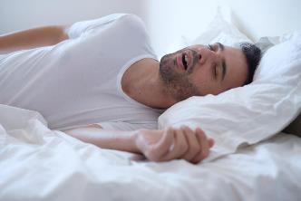
Sleep Apnea
Central Sleep Apnea: complete cessation of respiratory activity
Contributing Factors: more common in males, the obese, & middle to older age
Prevalence: occurs in 10-20% of population
Notes:
An association between obesity and OSAS has been noted in many studies, with moderate or severe obesity (body mass index (BMI) > 30 kg·m-2) in 60–90% of patients with OSAS. Central obesity, characterized by a high waist-to-hip ratio or large neck circumference, correlates better with OSAS than BMI, even in people with a normal BMI.
OSAS is more common in men than women. This has been attributed to differences in anatomical and functional properties of the upper airway, differences in craniofacial morphology and fat deposition, and different ventilatory responses to arousal from sleep. However, health professionals need to be particularly alert to the possibility of OSAS in women, as male bed partners may be less aware of the symptoms of obstructive breathing during sleep. The disease prevalence is higher in post-menopausal women and hormone replacement therapy is associated with a lower prevalence; the prevalence of OSAS increases during pregnancy, particularly in the third trimester.
Smoking is associated with a higher prevalence of snoring and OSAS, and alcohol can increase upper airway collapsibility leading to apneas.

Slide 28
Signs of Sleep Deprivation
Needing an alarm clock to wake up
Falling asleep within 5 minutes of hitting the pillow
Well-rested people take 10-15 minutes
Napping easily
High number on the Epworth Sleepiness Scale
Notes:
The main symptom of ongoing sleep loss is excessive daytime sleepiness, but other symptoms include:
•yawning
•moodiness
•fatigue
•irritability
•depressed mood
•difficulty learning new concepts
•forgetfulness
•inability to concentrate or a "fuzzy" head
•lack of motivation
•clumsiness
•increased appetite and carbohydrate cravings
•reduced sex drive

Slide 29
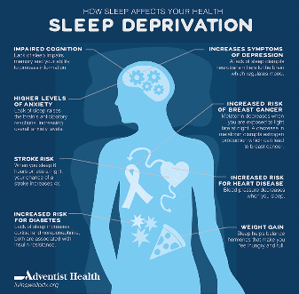
Sleep Deprivation
Chronic sleep deprivation has been shown to raise the risk for:
Depression
Obesity
Cardiovascular disease
Reproductive complications
These issues can lead to decreased productivity and increased healthcare costs for employee and employer alike.
Notes:
Effects of sleep deprivation
A sustained lack of sleep can have a serious impact on health. In the long term, chronic sleep deprivation has been shown to raise the risk for depression, obesity, cardiovascular disease and reproductive complications. These issues can lead to decreased productivity and increased healthcare costs for employee and employer alike.

Slide 30
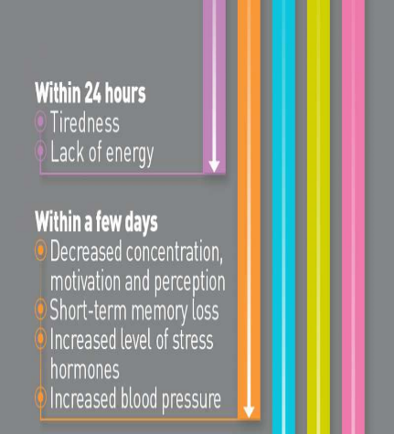
Sleep Deprivation
In the short term, lack of sleep can cause issues with:
Tardiness
Absenteeism
Concentration
Listening to others
Solving problems
Making decisions
Decreased attention, memory recall & vigilance
Notes:
In the short term, lack of sleep can cause issues in the workplace including increased tardiness and absenteeism. Workers may also have problems with concentration, listening to others, solving problems and making decisions as well as decreased attention, memory recall and vigilance.

Slide 31
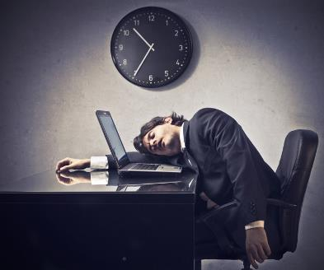
Sleep Deprivation
As your body’s sleep debt increases, the more likely you are to experience microsleeps—a brief episode of sleep which can last anywhere from a fraction of a second up to 30 seconds.
During a microsleep, you are temporarily unconscious.
2
Notes:
You can’t just play catch up on the weekends. As your body’s sleep debt increases, the more likely you are to experience microsleeps—a brief episode of sleep which can last anywhere from a fraction of a second up to 30 seconds. During a microsleep, you are temporarily unconscious.

Slide 32
Sleep Deprivation
Highly fatigued workers are 70% more likely to be involved in an incident resulting in injury.
Workers who report disturbed sleep are nearly twice as likely to die in a work-related incident.
Notes:
This is especially dangerous in the workplace. The National Sleep Foundation reports that highly fatigued workers are 70 percent more likely to be involved in an incident resulting in injury and workers who report disturbed sleep are nearly twice as likely to die in a work-related incident.

Slide 33
Sleep Deprived & Driving
A recent AAA Foundation report estimated 328,000 crashes annually due to drowsy driving, with 109,000 resulting in injury and 6,400 resulting in a fatality.
Drowsiness affects drivers in
much the same way as alcohol:
Reduced attentiveness
Slowed reaction time
Impaired judgment
Driving while drowsy increases crash risk by nearly 300%!
Notes:
Drowsy Driving
Lack of sleep also creates danger on the road. The problem is widespread. A recent AAA Foundation report estimated 328,000 crashes annually due to drowsy driving, with 109,000 resulting in injury and 6,400 resulting in a fatality. Drowsiness affects drivers in much the same way as alcohol: reduced attentiveness, slowed reaction time and impaired judgment. Driving while drowsy increases crash risk by nearly 300 percent.

Slide 34
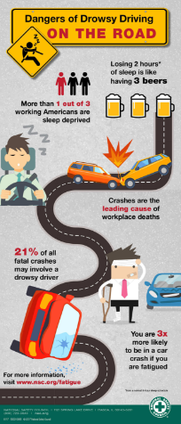
Sleep Deprivation
Whether you are driving on the job, commuting to or from work, or are off the clock…make sure you are not too drowsy to drive.
Pull over to a safe place and take a 15–20-minute nap if possible
If you are extremely fatigued, don’t attempt to drive; call a friend, family member, colleague, fleet dispatch, cab or ride share to complete your trip safely
Notes:
Whether you are driving on the job, commuting to or from work, or are off the clock, make sure you are not too drowsy to drive. Pull over to a safe place and take a 15-20 minute nap if possible. If you are extremely fatigued, do not attempt to drive; call a friend, family member, colleague, fleet dispatch, cab or ride share to complete your trip safely.

Slide 35
Sleep Deprivation
About 15% of the U.S. workforce does not keep a traditional schedule.
Drivers
Law enforcement
First responders
Nurses and doctors
Because of this schedule, their body’s internal clock, or circadian rhythm, is out of sync.
The circadian rhythm tells the body to become alert in morning and drowsy at night and produces sleep-promoting chemicals like melatonin.
Even though their schedules may be different, shift workers still need the same amount of sleep.
Notes:
Shift workers
About 15 percent of the U.S. workforce is comprised of workers who do not keep a traditional schedule. They include drivers, law enforcement, first responders, nurses and doctors. Because of this schedule, their body’s internal clock, also known as the circadian rhythm, is out of sync. The circadian rhythm tells the body to become alert in the morning and drowsy at night and produces sleep-promoting chemicals like melatonin. Even though their schedules may be different, shift workers still need the same amount of sleep.

Slide 36
Tips from the NSF*
Create and follow a sleep schedule. Go to bed and wake up at the same time every day.
Ensure your bedroom or sleeping area is quiet and dark - keep the temperature moderate - neither hot nor cold.
Make sure your bed is comfortable and remember that bedtime is for sleeping and not reading or watching TV.
Avoid the use of gadgets that emit light, especially smartphones and tablets. Using these devices before going to bed can inhibit restful sleep.
Don’t eat a heavy meal right before bedtime.
*National Sleep Foundation
Notes:
Here are some tips from the National Sleep Foundation:
• Create and follow a sleep schedule. Go to bed and wake up at the same time every day
• Ensure your bedroom or sleeping area is quiet and dark and keep the temperature moderate—neither hot nor cold
• Make sure your bed is comfortable and remember that bedtime is for sleeping and not reading or watching TV
• Avoid the use of gadgets that emit light, especially smartphones and tablets. Using these devices before going to bed can inhibit restful sleep
• Don’t eat a heavy meal right before bedtime

Slide 37
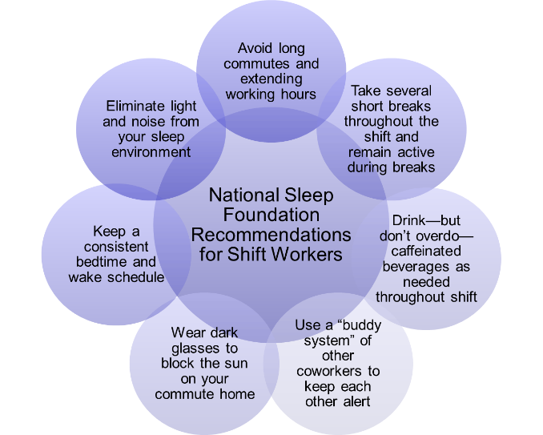
Sleep Deprivation
Notes:
The National Sleep Foundation recommends the following for shift workers:
• Avoid long commutes and extending working hours
• Take several short breaks throughout the shift and remain active during breaks
• Drink—but don’t overdo—caffeinated beverages as needed throughout shift
• Use a “buddy system” of other coworkers to keep each other alert
• Wear dark glasses to block the sun on your commute home
• Keep a consistent bedtime and wake schedule
• Eliminate light and noise from your sleep environment

Slide 38
Summary
The Relationship Between Sleep and Health is clear.
Not getting enough sleep can have profound consequences on a daily and potentially long-term health and mental well-being.
What many people do not realize is that a lack of sleep—especially on a regular basis—is associated with long-term health consequences, including chronic medical conditions like diabetes, high blood pressure, and heart disease, and that these conditions may lead to a shortened life expectancy.
Notes:
The Relationship Between Sleep and Health is clear.
Not getting enough sleep can have profound consequences on a daily and potentially long-term health and mental well-being.
What many people do not realize is that a lack of sleep—especially on a regular basis—is associated with long-term health consequences, including chronic medical conditions like diabetes, high blood pressure, and heart disease, and that these conditions may lead to a shortened life expectancy.

Slide 39
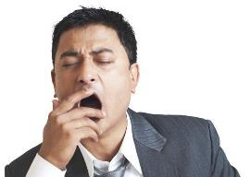
Summary
Fatigue is more a long-term issue and getting rest does not cure the affects.
Stress can cause fatigue, to avoid the effects, exercise can help your body deal with stress.
If you are experiencing long term sleep issues consult your doctor.
Notes:
Fatigue is more a long term issue and getting rest does not cure the affects.
Stress can cause fatigue, to avoid the effects, exercise can help your body deal with stress.
If you are experiencing long term sleep issues consult your doctor.

Slide 40
Contact Information
Health & Safety Training Specialists
(717) 772-1635
RA-LI-BWC-PATHS@pa.gov

Slide 41
Questions?

Slide 42
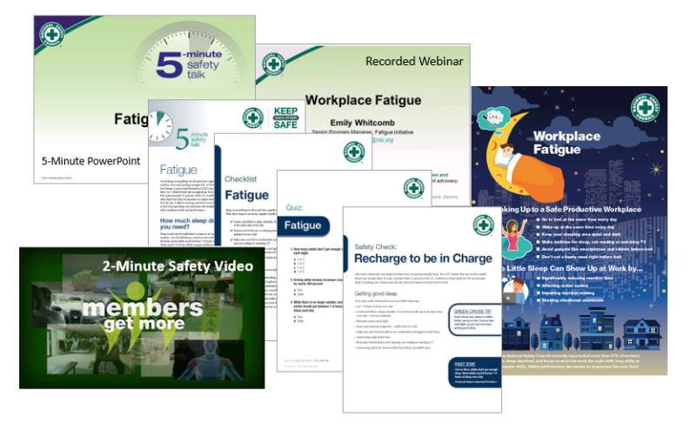
NSC Fatigue Safety Toolkit
Visit nsc.org/members to download this toolkit and other great resources.
Notes:
The National Safety Council has many good resources on the topic.

Slide 43
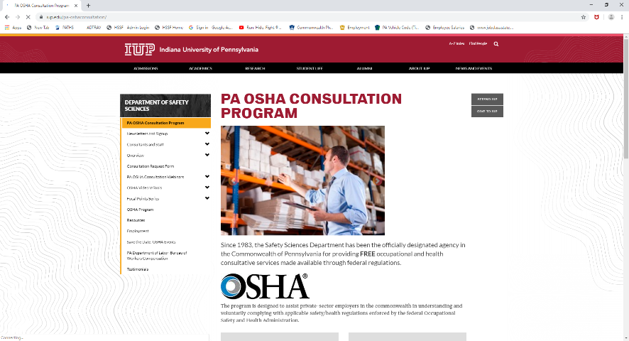
IUP OSHA Consultation Program
Telephone Number 1-800-382-1241
Notes:
Since 1983, the Safety Sciences Department of Indiana University of Pennsylvania has been the officially designated agency in the Commonwealth of Pennsylvania for providing FREE occupational and health consultative services made available through federal regulations.
The program is designed to assist private-sector employers in the commonwealth in understanding and voluntarily complying with applicable safety/health regulations enforced by the federal Occupational Safety and Health Administration.
This program was designed to assist small business employers with 500 or less employees, however program representatives are able to answer OSHA related questions.

Slide 44
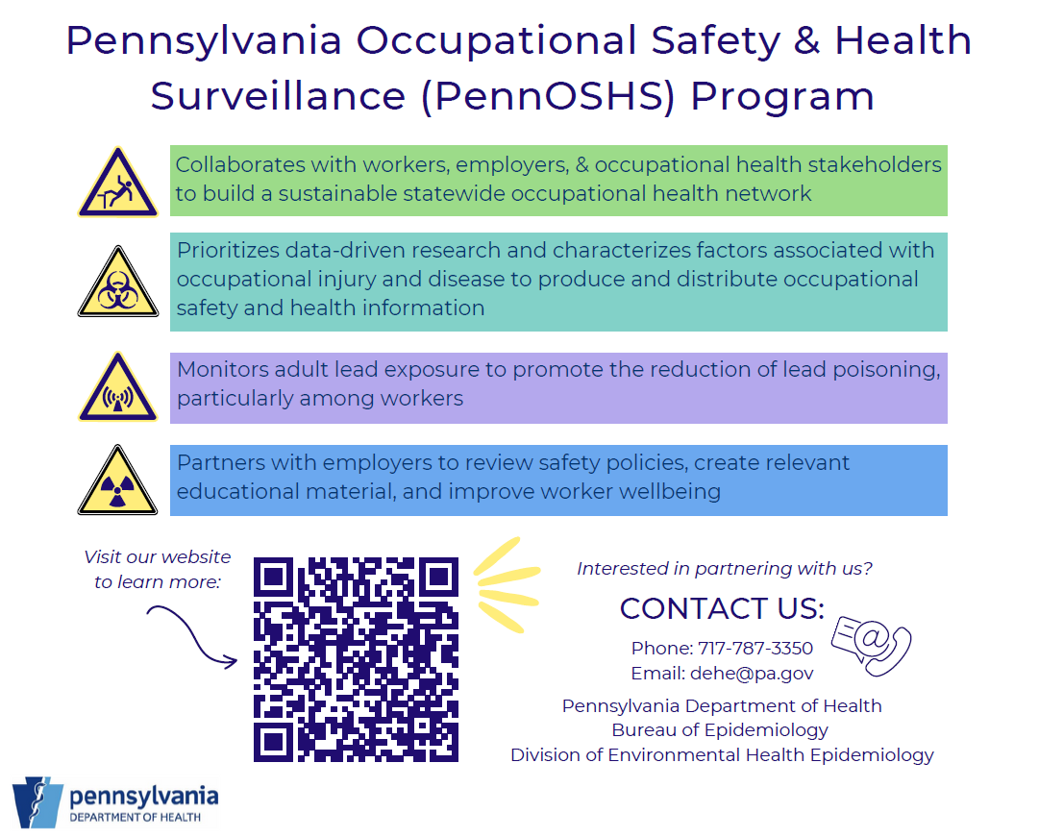
PennOSHS Program

Slide 45
Bibliography
Dr. Terri Prodoehl, Health sciences
James Madison university, July 2009
Learn more at
nsc.org/fatigue
people.uncw.edu/okinek/psy347/Files/Sleep%20Disorders
Disorders Website, University of MD
http://www.umm.edu/sleep/adult_sleep_dis.htm
MEMBERSHIPINFO@nsc.org

Slide 46
Bibliography
https://www.sleepfoundation.org/press-release/lack-sleep-affecting-americans-finds-national-sleep-foundation
https://www.purica.com/sleep/10-reasons-people-dont-get-enough-sleep/
Charles M. Morin, ... Simon Beaulieu-Bonneau, in Principles and Practice of Sleep Medicine (Sixth Edition), 2017

